Slide 1


Impact and Lessons
Learned, 2017-2021
Notes:
Possible idea: Every alternative page could be a picture from the project developer

Slide 2

USICEF IMPACT: Maximizing philanthropic impact to scale distributed solar energy in India
USICEF is India’s first project preparation facility (PPF) to help mobilize small- and mid-scale distributed solar energy projects. It is unique in its private PPF structure with reuse of grants, a new financially suitable and scalable approach to renewable energy and energy access philanthropy.
Since launching in 2016, USICEF supported 47 solar power projects, which went on to mobilize 30x in commercial debt over the initial grants provided.

Slide 3
CONTENTS
p. 03 Scaling-up Distributed Solar Power: The Need for USICEF
p. 06 What is USICEF and how it works
p. 11 USICEF Impact Highlights: 2017-2021
Notes:
Case study annotation seemed unnecessary. Saved into notes just in case. *Case studies of many of USICEF’s project developers are highlighted throughout the report.

Slide 4
SCALING DISTRIBUTED SOLAR POWER: THE NEED FOR USICEF

Slide 5
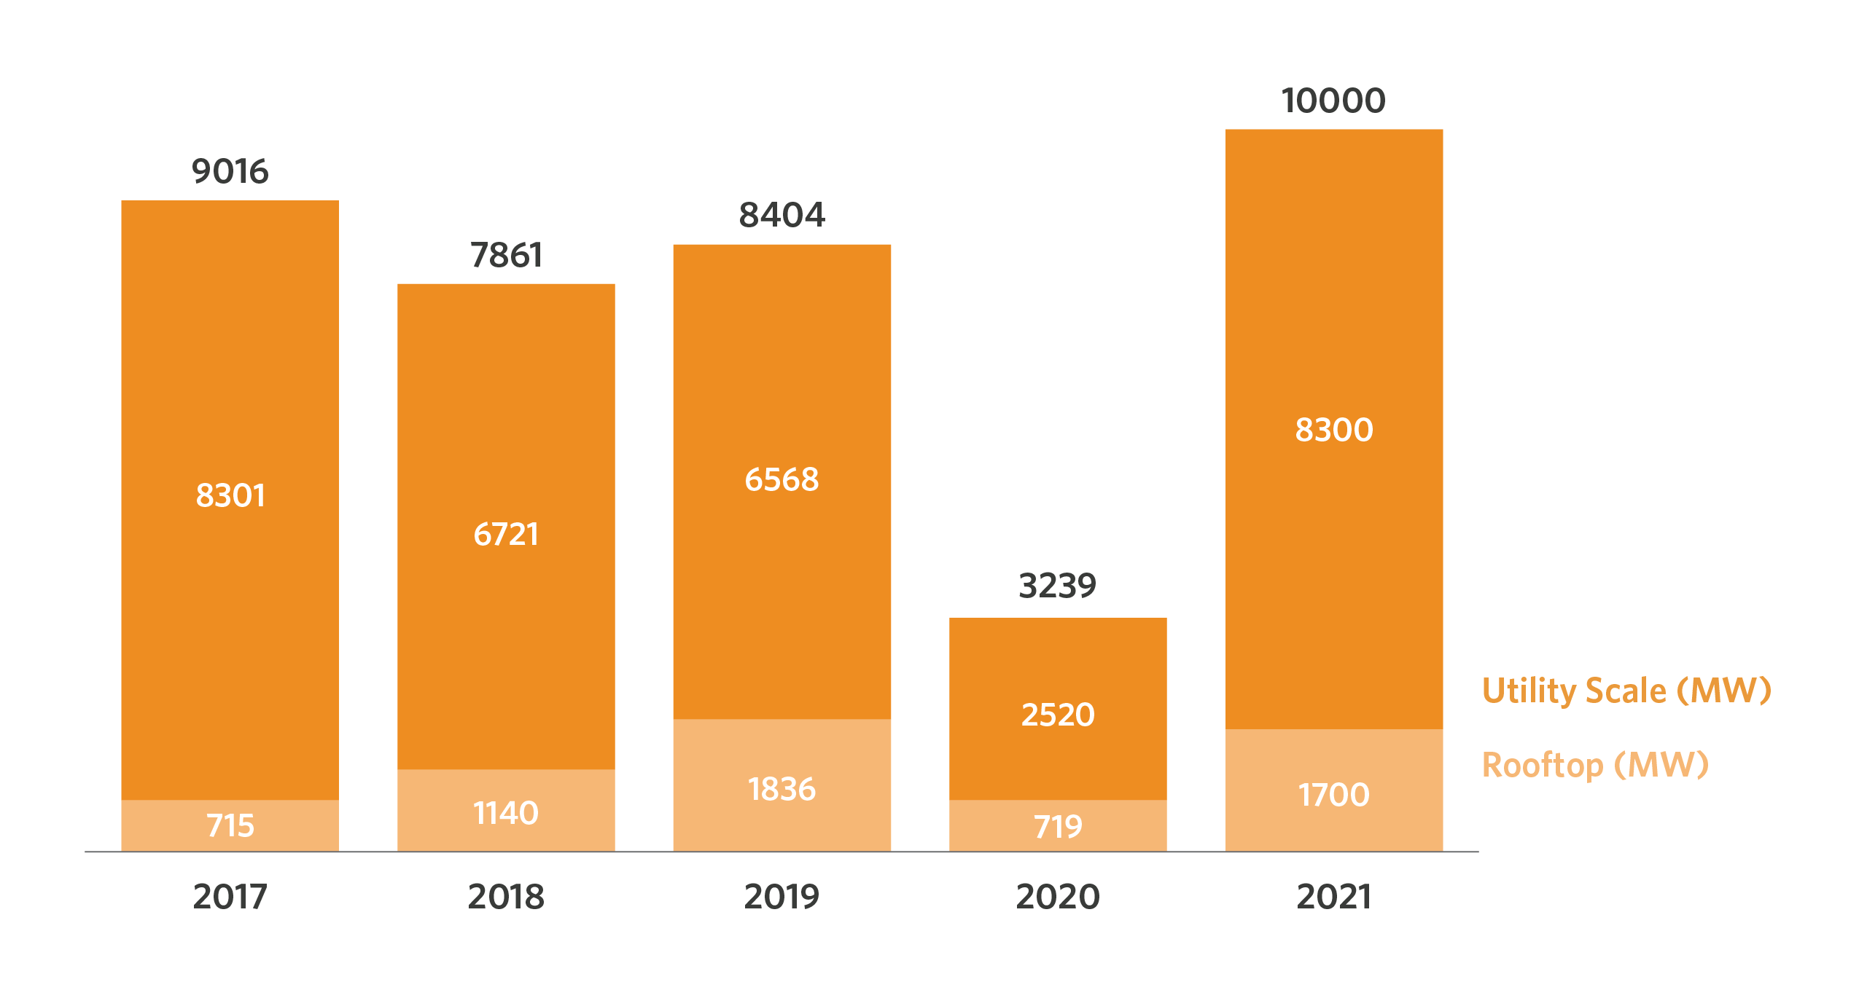
India’s distributed renewable energy sector requires significant investment to meet national targets
India plans to install 175 GW of renewable energy projects by 2022.
Despite installed capacity rising six-fold to nearly 86 gigawatts in 2019,
only one-third of distributed generation targets are expected to be met by 2022.
Source: JMK Research
Annual renewable energy installation trends
Source: Bridge to India
Notes:
Year
2017
2018
2019
Rooftop (kW)
715
1,140
1,836
Utility Scale (kW)
8,301
6,721
6,568
(Source – Bridge to India)

Slide 6
WHAT IS USICEF & HOW DOES IT WORK?

Slide 7
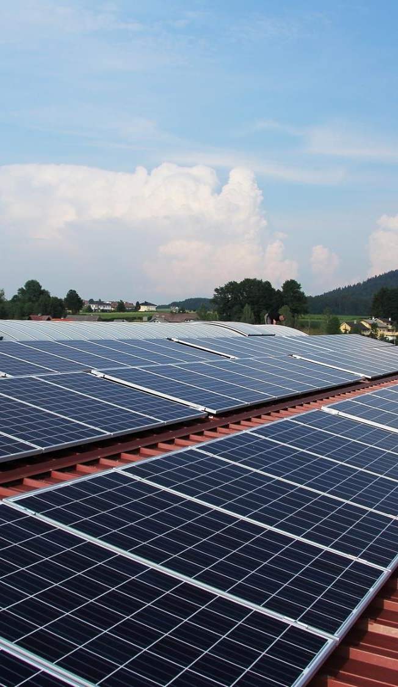

The U.S.-India Clean Energy Finance (USICEF) initiative is India’s first project
preparation and pipeline development facility to help promising distributed solar projects develop into viable investment opportunities and drive long-term debt financing.
USICEF is a critical step towards increasing access to reliable energy in underserved regions in India.

Slide 8












USICEF stems from a partnership between the Indian Ministry of New and Renewable Energy, the Overseas Private Investment Corporation (OPIC), and a consortium of foundations and investors.
PARTNERS
PROJECT MANAGER

Slide 9
How USICEF works: 5-step process
1.
2.
3.
4.
5.
CALL FOR PROPOSALS
SCREENING & SELECTION
SELECTION OF SERVICE PROVIDERS
GRANT DISBURSEMENT
ONGOING SUPPORT
The Project Developer applies for a USICEF grant for project preparation support.
The application is evaluated by
CPI, as the Program Manager,
and the Advisory Committee.
Upon approval, the Program Manager engages USICEF’s network of empaneled Service Providers to provide the relevant project support.
Grant money is transferred to the Service Provider upon successful delivery of services.
Project Developers receive project development support and become eligible for long-term financing from OPIC and other institutions.

Slide 10



PROJECT PREPARATION
Grant funded technical assistance helps prepare high quality investment grade project proposals to increase prospects of obtaining long-term debt financing
USICEF’s three ingredients to success
PROMISING & TRANSFORMATIVE PROJECTS
Promising, actionable, catalytic, and financially sustainable projects reduce risks and barriers to investment in sustainable development.
MOBILIZING FINANCE
Enables a critical mass of projects to unlock access to capital from public and private sources which in turn will benefit disadvantaged communities in India

Slide 11
USICEF IMPACT HIGHLIGHTS: 2017-2021

Slide 12







































Since 2017, USICEF has awarded grants to over 47 early-stage businesses for various project preparatory activities including legal, technical, and financial advisory.
GRANT AWARDEES

Slide 13

These early-stage businesses belong to six main sub-segments that USICEF targets
SUPPORTED
SUB-SEGMENTS
Rooftop solar (Commercial & industrial)
Mini-grids
Rooftop residential & institutional
Solar Home Systems
Financial intermediaries
Small ground mounted solar projects
Solar Based EV Charging
Notes:
Still needs work

Slide 14
The Program has achieved debt mobilization of 30x that translates to
64%
$285M
30 out of 47 supported developers have successfully mobilized debt using USICEF grants
mobilized in debt from 15 different international and domestic lenders
Notes:
I think this slide could use some refining with the text. Feels redundant.

Slide 15
Potential USICEF Impact
USD $6.4M
Grant support committed
670 MW
Capacity installed
960,000 MT P.A
CO2 emissions avoided
960,000 MWh p.a Electricity generated
USD $340M
Expected debt funding
20,600
New jobs
Notes:
Deleted projects spread across 20 Indian States as it’s stated again on next slide

Slide 16
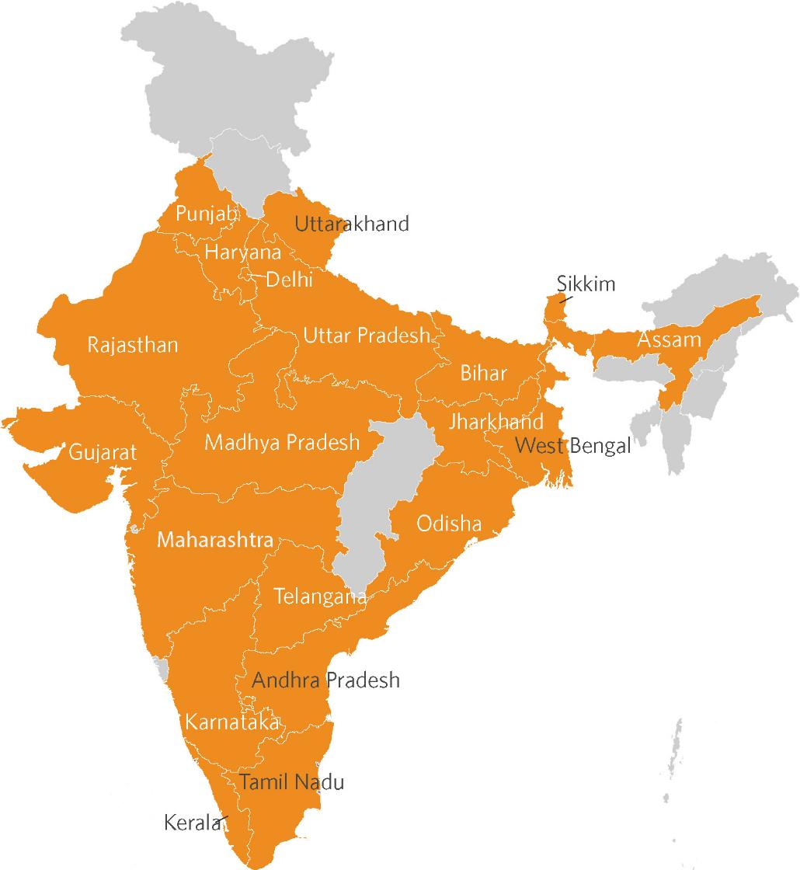
Projects spread across 20 INDIAN STATES

Slide 17
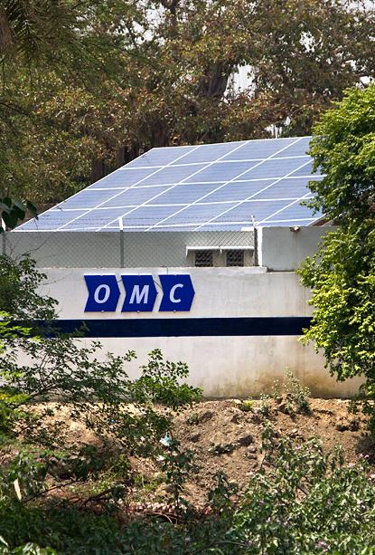

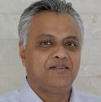
Case Study
OMC is the pioneer of its unique ABC business model, wherein we set up solar power plants with mini grids and bring energy access to remote rural locations with limited or no grid connectivity. We serve “A”nchor customers (telecom towers), small and medium rural “B”usinesses and rural “C”ommunities.
Our experience with USICEF has been very positive and encouraging, as they provided us with financial support enabling us to engage consultants for conducting due diligence for a proposed financial closure.
OMC
PROGRESS TO DATE
260 plants with mini grids on the ABC model
90 sites serving telecom customers
Around 16.4 MW total installed capacity (conventional + renewable)
20,000 “B” and “C” customers; 206 “A” customers
Ajaita Shah
Founder & CEO
Rohit Chandra
CEO, OMC Power
“USICEF has been an important partner for Frontier Markets in its journey and helped us to further our mission of supporting rural women while addressing the electricity access challenges”
“Our mission is ‘Power, Everywhere’ to bring clean, green, affordable energy access to the bottom of the pyramid. USICEF has been a valuable partner of OMC in our efforts to fuel growth . They provided us with timely catalytic support that enabled the same.”

Slide 18
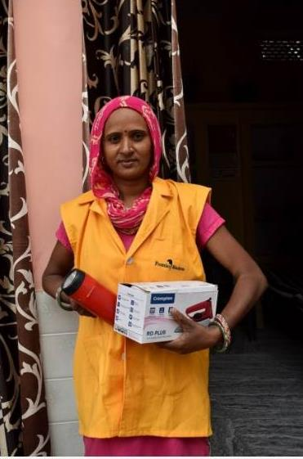
Case Study
Frontier Markets is a social tech enterprise that focuses on connecting products and services to rural customers in India. It is an end-to-end commerce platform that provides last-mile products and services, delivered at the doorsteps of consumers in villages through an assisted commerce model run by rural women entrepreneurs called Saral Jeevan Sahelis. Solutions include: in clean energy, agri, home and mobile appliances, as well digital and essential services
Our association with USICEF has proved to be a successful story and helped us to reach out to lenders and raise debt capital for our expansion activities.
Frontier Markets
PROGRESS TO DATE
Sold 1 Million solar products to 600,000 households
Supported 12,000 women entrepreneurs
Provided 1.2+ million solutions in clean energy, agri, home and mobile appliances
CO₂ mitigated: 2.5 Million tons
Ajaita Shah
Founder & CEO
“USICEF has been an important partner for Frontier Markets in its journey and helped us to further our mission of supporting rural women while addressing the electricity access challenges”

Slide 19
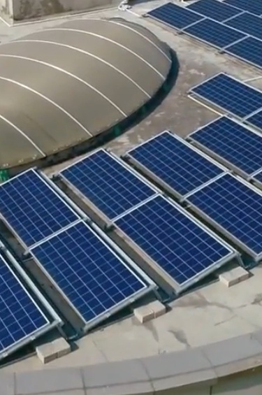

Case Study
candi was incorporated 2.5 years ago, with the intent of unlocking the potential of solar for SMEs which, until that time was a largely overlooked market, fiscally constrained and unable to readily embrace the transition to a sustainable and renewable future.
Equipped with a vision on how to streamline everything from contracts to credit screening for this sector, we initiated our journey in India with the invaluable support of USCIEF from very early on. Leveraging this assistance to realise our vision, candi now straddles two countries, has over 20 clients across almost 5MW and has successfully closed Series A as well as debt rounds with international investors.
candi
PROGRESS TO DATE
Clean energy capacity installed: 16.3 MW
Direct or Indirect employment created: 41
Clients signed on to solar: 50
Ajaita Shah
Founder & CEO
Rohit Chandra
CEO, OMC Power
Philippe Flamand,
CEO, candi solar
“USICEF has been an important partner for Frontier Markets in its journey and helped us to further our mission of supporting rural women while addressing the electricity access challenges”
“Our mission is ‘Power, Everywhere’. USICEF has been a valuable partner of OMC in our efforts to fuel growth . They provided us with timely catalytic support that enabled the same.”
“USCIEF was instrumental in allowing candi to focus on the building blocks of an investable/lendable company far earlier in its journey than would otherwise have been possible, ultimately accelerating candi’s growth and impact.”

Slide 20

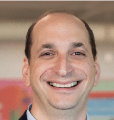
Case Study
HCT Sun had sought and received USICEF’s grant a couple of years back for strengthening its internal business process, with regards to financial parameters for our business model, technical standards, health and safety standards, credit analysis tools for our customer segment, and legal contracts for our projects.
Thanks to USICEF’s support, we could engage with the best consultants from across the country in these fields. Their support was especially helpful in our business operations since we were trying to introduce a concept to a largely uncharted area.
HCT Sun
PROGRESS TO DATE
Signed up over 6,600 kWp worth of projects
~ 4,500 kWp revenue generating projects
3,900 kWp in projects ready to come online by early 2021
Ajaita Shah
Founder & CEO
Aryeh Glickman
Founder & Director, HCT Sun
“USICEF has been an important partner for Frontier Markets in its journey and helped us to further our mission of supporting rural women while addressing the electricity access challenges”
“USICEF has been a huge help in accessing top tier consultants who helped us raise our standards to those of international companies with a lot more experience and a much larger portfolio.”

Slide 21














Media Coverage

Slide 22
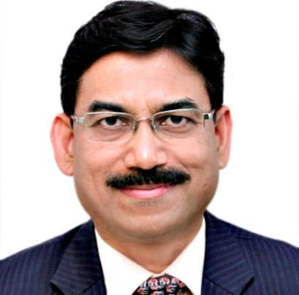
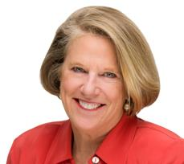
Projects under USICEF benefit from the support of a robust USICEF network
MANISH CHOURASIA
Managing Director, TCCL
ELIZABETH L. LITTLEFIELD
Former President and CEO, OPIC
“For India’s clean energy transition, distributed solar energy is critical. USICEF has played a vital role in supporting rooftop solar developers through their most critical phase of project development and helping them scale up. The TCCL team is pleased to partner and finance many promising distributed rooftop solar projects through USICEF”
“The USICEF initiative is a critical step towards increasing access to energy in underserved regions in India. This public-private partnership presents the opportunity for OPIC to finance and deploy high-impact development projects that support underserved communities throughout India to help the country meet its energy goals.”

Slide 23


This report was prepared by Climate Policy Initiative,
Project Manager for the US-India Clean Energy Finance Initiative
With deep expertise in finance and policy, CPI is an analysis and advisory organization that works to improve the most important energy and land use practices around the world. Our mission is to help governments, businesses, and financial institutions drive economic growth while addressing climate change. CPI has six offices around the world in Brazil, Europe, Kenya, India, Indonesia, and the U.S.
Climate Policy Initiative, as the project manager:
Manages USICEF
Guides the selection process
Develops partnerships with international and national lenders and facilitates debt for supported projects
Convenes the committee meetings

Slide 24



US-INDIA CLEAN ENERGY FINANCE www.USICEF.org
@climatepolicy
/company/climatepolicyinitiative

