Slide 1
Global Landscape of Climate Finance 2021
Supported by:
Notes:
Welcome to the Climate Policy Initiative webinar on the Global Landscape of Climate Finance 2021, which was published today.
This webinar will be presented by some of the CPI Analysts who were heavily involved in the production of this year’s Landscape – Baysa Naran, Matthew Solomon, and Paul Rosane – following an introduction from Dr. Barbara Buchner, Global Managing Director at CPI.
The format will be a half-hour presentation followed by a question and answer session. You are welcome to submit a question at any point via the Q&A button at the bottom of your screen.
The webinar is being recorded and will be available on the CPI website in the coming days.
And now, I will turn it over to Barbara.
Thank you all for joining us today as we launch our 2021 Global Landscape of Climate Finance report.
With just weeks to go until COP26, this report is being released at a critical time.
As you will soon hear, finance flows are nowhere near the estimated needs. High-emissions investment in the meantime continues to flow in key sectors which are curbing the impact of new finance in climate mitigation and adaptation. Climate investment should ideally count in the trillions, whereas fossil fuel investments should virtually stop this decade.
In fact, this decade will make or break the transition to a sustainable, net zero world. Our findings indicate the urgent need to work towards setting credible commitments - with clear transition plans - to meet our climate targets.
To meet these goals, we need to shift away from baby steps to giant leaps, incrementalism to radical action, and from excuses to execution.
At Climate Policy Initiative, we hope that by providing decision makers with robust and comprehensive information on progress against real climate investment needs, it will enable them to enact ambitious policies.
If you are not familiar with CPI, we are an analysis and advisory organization with deep expertise in finance and policy. We work with governments, finance institutions, and businesses to drive economic growth while addressing climate change. We have six offices around the world in Brazil, India, Indonesia, Kenya, the U.S., and the UK.
<Change slides>

Slide 2
CPI flagship report
The most comprehensive assessment of climate finance flows
Informs policy makers and investment leaders including UNFCCC, IPCC, G7 and others
This edition closes a decade of climate finance tracking
Notes:
The Landscape has the most comprehensive information available about the scale, key actors, instruments, recipients, and uses of finance supporting climate change mitigation and adaptation in 2019 and 2020. We have been doing this analysis for over a decade now.
Previous editions of the report have served as the basis for the Intergovernmental Panel on Climate Change report’s chapter on climate finance and the UNFCCC's Biennial Assessment and Overview of Climate Finance Flows, and as background for G7 statements.
Let me also acknowledge that this report made possible by support from:
The Department of Business, Energy and Industrial Strategy of the government of the UK
The Federal Ministry of the Environment, Nature Conservation and Nuclear Safety of Germany
Federal Office for the Environment of Switzerland and
Norwegian Ministry of Climate and Environment
<Change slides>

Slide 3
A milestone edition
Two publications: today’s pre-release and a full narrative report in November - December
Innovations & improvements in 2021:
Reformed sector classification
Bolstered investment need estimates
Data on gender-tagging
Improved assumptions
Project case study
And more…
Please stay tuned for the full narrative report in November
Notes:
This year we have made several innovations including:
Reforming our sector classifications to show where climate finance is flowing in which economic sectors
Bolstering investment need estimates; and
Collecting data on gender-tagging and climate finance.
We will release a more detailed analysis in a full, narrative report that will be published in early December, so please stay tuned for that.
<Change slides>

Slide 4
Agenda
Key findings
Private Financial Institution Net Zero commitments
A closer look at
Mitigation finance
Adaptation finance
Geographic flows
Conclusion
Notes:
Quickly on the agenda, we’ll start looking first at the scope of finance flows.
Then we’ll get into various breakdowns of the total landscape of climate finance globally, including instruments, public and private actors, uses and sectors, and geographical splits. Please note that we will provide investment totals in US dollar terms in annual averages for 2019 and 2020.
We’ll follow with a brief discussion on opportunities to scale climate finance based on the trends we’re seeing in the data and drawing on CPI’s other research.
And we’ll end with some time for Q and A.
Let me now hand it over to my colleague Baysa who will take you through the scope of our report, headline figures and discussion around financial instruments and private and public actors. Baysa, over to you.
<Change slides>

Slide 5
Key Findings
Notes:
<Change slides>

Slide 6
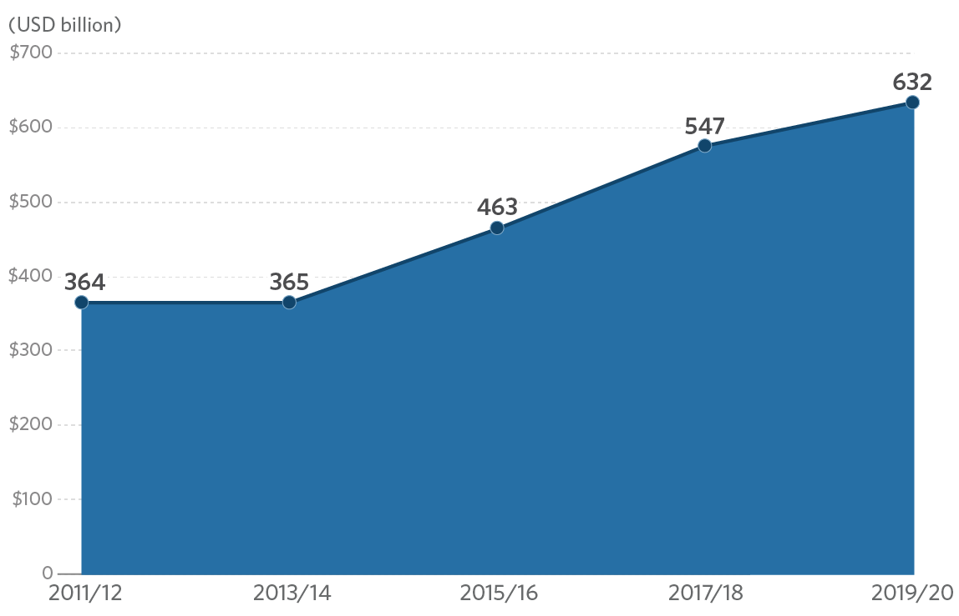
Key findings
Global climate finance flows reached USD 632 billion in 2019/2020, but with tepid growth rate
Figure 1.2: Global climate finance flows between 2011 – 2020, biannual averages
574
Notes:
Thank you, Barbara
Let me first take you through our headline numbers before going into details.
It has been a decade since CPI started tracking annual finance flows in climate mitigation and adaptation. In 2019 and 2020, annual flows reached 632 billion dollars on average.
In this diagram, you can see that public and private actors have been steadily increasing their climate investments in the last decade. But the flows largely plateaued in the last 4 years (Figure 2). This is worrying because Covid-19’s impact on climate finance is still yet to be observed in the coming couple of years
Also the flows increased by only 10% compared to 2017/2018. This is much slower than in the previous periods. Annual climate finance flows in the previous years, for example, increased by 24 or 25 percent.
<Change slides>

Slide 7
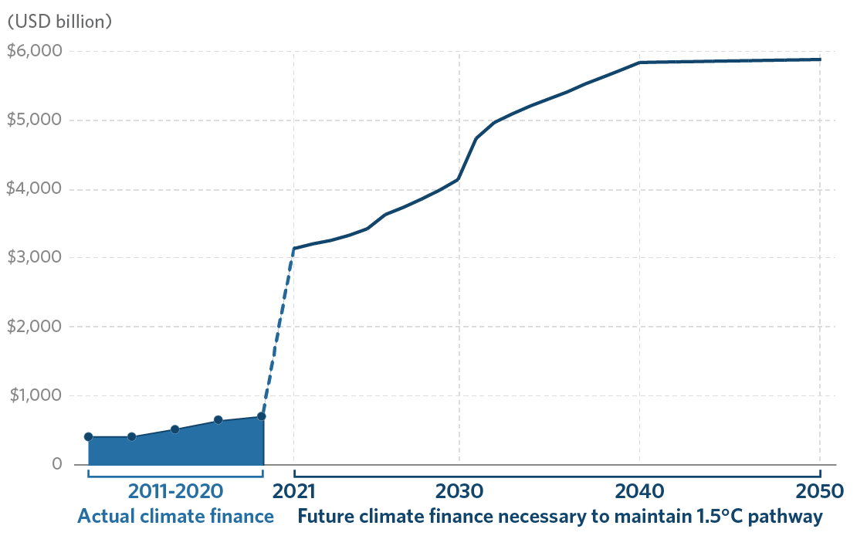
Key findings
Current investment levels are nowhere near enough to limit global warming to 1.5 °C
Figure 1.3: Global tracked climate finance flows and the average estimated annual climate investment need through 2050
Notes:
On top of this challenge, there is still a significant gap between the current flows and what’s needed for a successful low-carbon transition. This year, we’ve done a comprehensive literature review on the climate mitigation and adaptation investment needed through 2050. These studies explore ranges of investment required based on different pathways for net zero by 2050. As shown here, there is a huge gap between the current annual average flows and the required investment as identified by various reputable studies from IEA, IRENA, BNEF and Global Commission of Adaptation.
While there is no definitive estimate of the investment required to achieve global climate goals, it’s clear that incremental increases in climate finance will not be sufficient. The finance should increase decisively and should count in trillions, not billions.
<Change slides>

Slide 8
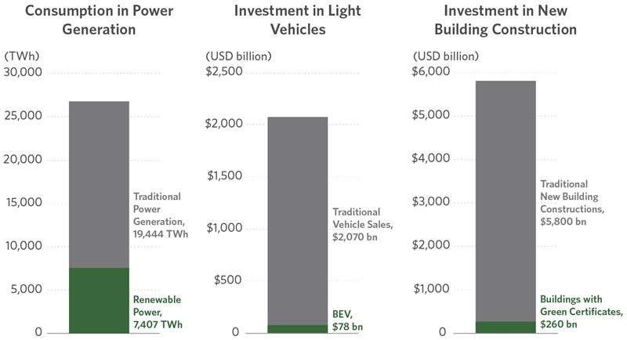
Executive summary
Achieving net-zero will require all public and private actors to align their finance with Paris goals
Notes:
Just to be clear, these trillions are not unrealistic numbers or unavailable funds - the money Is there.
When you look at conventional non-climate finance investment, we know that trillions are already spent on light vehicle duties alone that consume petrol.
We build new buildings that are mostly high energy intensive. This is not ideal when the global energy mix is still primarily fossil fuel based.
The question is how do we get the trillions in climate investment? There is no single roadmap, but achieving net-zero will require all public and private actors to align our finances with Paris goals.
<Change slides>

Slide 9
What are we tracking?
We don’t track…
Risk mitigation instruments
Policy-induced revenue support mechanisms or other public subsidies
Secondary market transactions
Investments in sales and R&D
Fossil fuel-based lower-carbon and energy-efficient generation
We track…
Annual climate finance commitments into new low carbon, climate resilient projects/activities
Total primary financial transactions and investment costs or, where tracked, components of activities that directly contribute to adaptation and/or mitigation
No double counting
Notes:
So what exactly does the Landscape track?
We aim to provide a comprehensive overview of new annual primary finance flows into climate mitigation (that is to avoid and reduce emissions) and climate adaptation interventions (that is improving resilience to the impacts of already manifesting climate change).
In doing so, we track financial commitments, when an investment decision has been made at the time of financial close of a project, rather than when the actual disbursement of the funds may occur over a project lifetime.
The focus on primary transactions, ideally at project level, rather than on secondary market activities, is to include investment into new productive assets or activities so we can really focus on the real economy changes.
We take due care in our methodology that is developed over the years and we aim for a non-double counted number, maximize data granularity and adhere to a principle of conservativeness when reporting our numbers. This has a significant effect on what we track.
For example,
· We do not include risk mitigation instruments such as guarantees or insurance in the total flows;
· We don’t include secondary market transactions such as non-project bonds, mergers and acquisitions etc.
<Change slides>

Slide 10
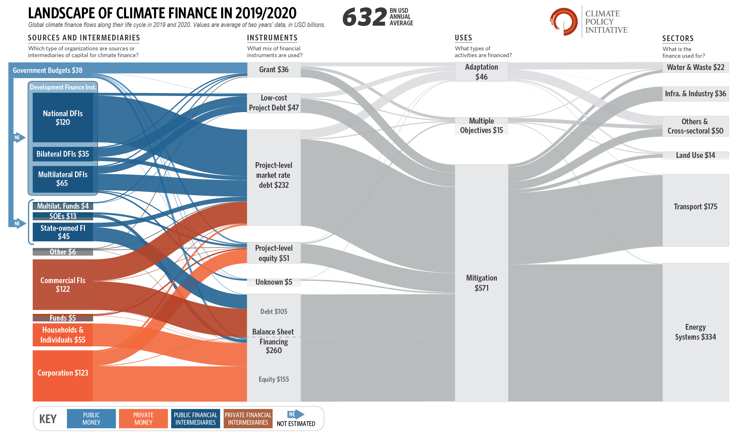
Key findings
Notes:
Let me now provide you an overview of the Sankey diagram for this year.
This diagram provides a snapshot of climate finance flows through the lifecycle.
As you see, on the left hand side, capital sources and intermediaries are categorised into private and public, which are further broken down by categories such as commercial financial institutions or corporations, government actors or multilateral climate funds etc.
Next, we see the instruments used to raise finance, such as debt and equity and We also include grants.
Every financial flow is broken down into mitigation, adaptation, and dual benefits. Dual benefits projects target both mitigation and adaptation objectives.
Finally, on the right hand side, the Sankey concludes in the economic sectors,, where the finance is spent, such as renewable energy, transport, and agriculture and land use.
The numbers here represent an annual average over 2019 and 2020. We present annual averages to smooth out annual fluctuations in data.
<Change slides>

Slide 11
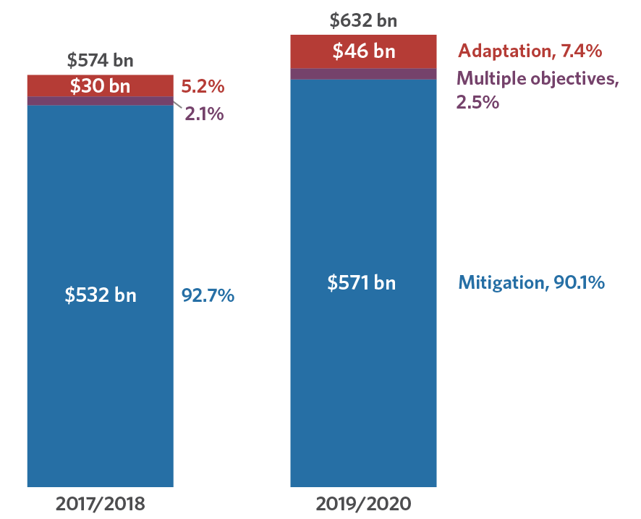
Executive summary
Majority of climate finance went to mitigation, but adaptation finance is gaining momentum
Figure 1.5: Biannual average climate finance by mitigation, adaptation and dual objectives (USD bn)
Notes:
Let’s take a closer look at climate finance breakdown by use.
Mitigation finance continues to dominate with over 90% share in total climate finance.
However, annual adaptation finance increased by almost 53% in the last two years compared to the previous two years and its total share in climate finance increased to 7%. Almost all of adaptation finance is financed by public actors.
Projects with dual objectives increased by 23% to 15 billion showing also increased participation from the private sector.
<Change slides>

Slide 12
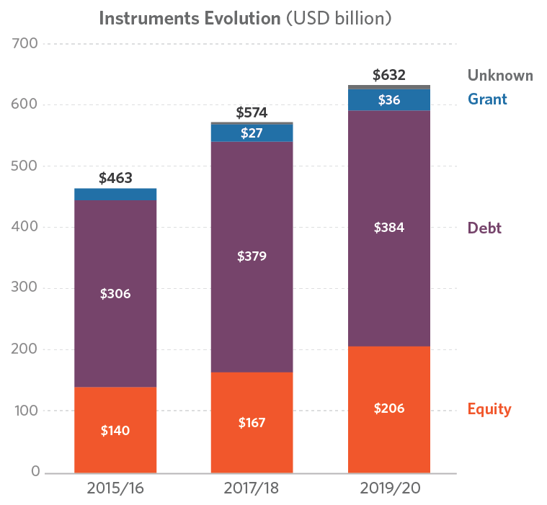
Financial instrument
Debt remains the main instrument for climate finance, but equity’s share and amount has increased.
Figure 3.1: Climate Finance by instrument (USD bn)
Notes:
Similar to previous years, most climate finance in 2019 and 2020 was raised as debt and primarily market rate debt.
Low-carbon transport and renewable energy systems received a larger portion of project level market-rate debt of which public institutions provided most of it.
Equity investments, the next-largest category after debt, increased its share of total climate finance flows, which is mostly corporate actors. While renewable energy continues to be the main destination of equity flows, we see an increase in transport and buildings & infrastructure sectors
And finally, grants increased their share of climate finance, as public actors seek to build strong enabling environments across a range of sectors. Annual grant finance averaged 36 billion dollars or 6% of total flows in the last two years which is a 5% increase compared to the previous period.
<Change slides>

Slide 13
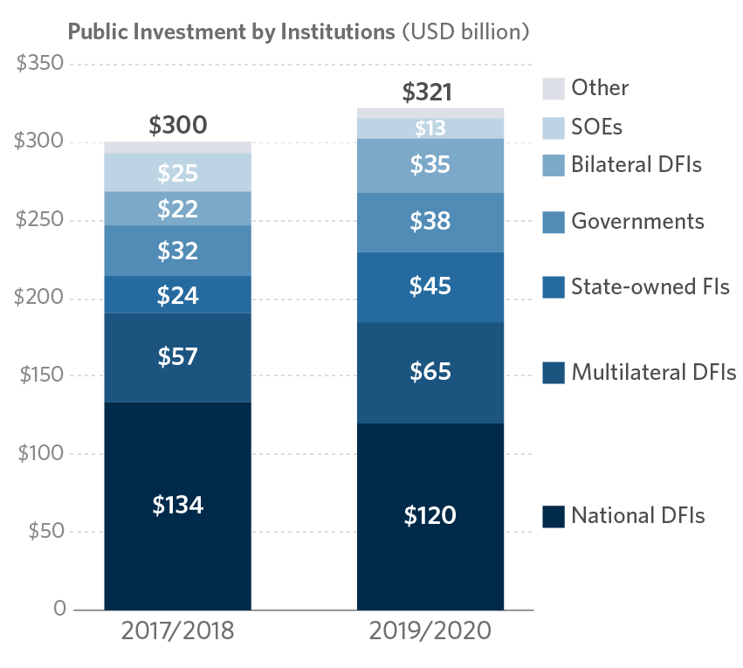
Sources and intermediaries
Public actors slightly ahead of private actors
Figure 2.1: Public investment by institutions (USD bn)
Notes:
Let’s look at public actors in more details.
The overall share of tracked climate finance provided by public sources are now slightly more than half of the total which is a relatively new trend. CPI has been working on improving our analysis on the role of state owned entities in climate finance which were previously included as private sector actors.
Development financial institutions (national, multilateral and bilateral) continued to provide the majority of public finance, contributing about 220 billion dollars annually.
State-owned Financial Institutions share increased which is partly due to improved data points on the flows in East Asia and Pacific as well as an uptake of renewable energy financing in the region.
Tracked climate finance from government budgets and agencies also increased by 17%. As in previous years, the growth is driven by low carbon transport and delivered primarily through grants.
<Change slides>

Slide 14
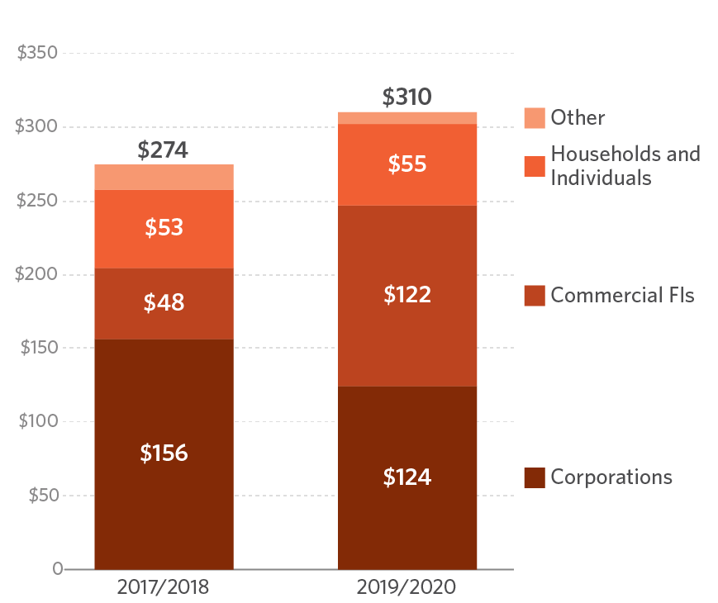
Sources and intermediaries
Commercial financial institutions made the biggest stride in growth
Figure 2.2: Private investment by institution type (USD bn)
Notes:
Moving on to private finance.
Private actors provided 310 billion dollar per year during the two year period, that is a 13% increase from the 2017/2018 average.
Within the private actors, we see that commercial financial institutions made the biggest stride in growth, increasing their share in private climate finance from 18% to 39% in the last two years. Banks are playing more prominent role as intermediaries of sustainable and green debt instruments.
Households take the third largest share of annual climate finance. For example, their annual spending on electric vehicles was 25 billion dollars on average over the last two years 2019/2020.
This CPI took a close look at private sector financial institution net zero commitments, and I will now handover to Matthew Solomon, who will discuss the findings from this study.
<Change slides>

Slide 15
FI commitments
Notes:
Thank you, Baysa. We will get back to the Global Landscape in a few minutes, but first I will highlight another report CPI is releasing today.
This report, titled Private Financial Institutions’ Commitments to Paris Alignment, uses a completely different methodology to track progress towards climate goals - we looked at what announcements financial institutions are making for future action. These are entirely voluntary goals and don’t represent actual finance flows. We wanted to put in context the major headlines you may have seen over the last few years from big institutions like BlackRock and HSBC and the launch of a variety of net zero coalitions and target-setting efforts. In addition to the report, we have a data download on our website containing all of the commitments we tracked.
This report was made possible with support from the Climate Emergency Collaboration Group, and I want to thank those members of the COP26 unit and Climate Champions teams who provided valuable feedback
< Change Slide >

Slide 16
301 financial institutions – representing USD 93.3 trillion of financial assets – have committed to net zero by 2050, mainly in Western Europe and US & Canada
Region | Financial Institutions Committed to Net Zero | Assets Committed to Net Zero (USD billion)
Western Europe | 181 | $ 44,267
US & Canada | 62 | $ 40,291
East Asia and Pacific | 15 | $ 7,006
Others | 43 | $ 1,746
Notes:
We found that 301 financial institutions - representing over 93 trillion of financial assets - are now committed to net zero by 2050. As you can see in this table, the vast majority of institutions and assets that have made this commitment are in Western Europe and US/Canada. These markets contain most of the world’s investable capital, but also have more available data and support for sustainable policies.
Some institutions have announced net zero targets since this data was collected last week, so the overall number is increasing seemingly by the day.
< Change Slide >

Slide 17
Asset managers and banks are leading the way in net zero targets
Actor Type | Financial Institutions Committed to Net Zero | Assets Committed to Net Zero (USD billion)
Asset manager | 131 | $ 31,109
Commercial bank | 72 | $ 49,439
Insurer | 22 | $ 3,123
Asset owner | 50 | $ 2,971
Multiple | 13 | $ 4,345
Unknown | 13 | $ 2,316
Notes:
We focused on four different actor types in this analysis: asset managers, commercial banks, insurers, and asset owners. Of these, asset managers and commercial banks have the most assets committed to net zero - including all of the 20 largest global asset managers and half of the largest commercial banks.
< Change Slide >

Slide 18
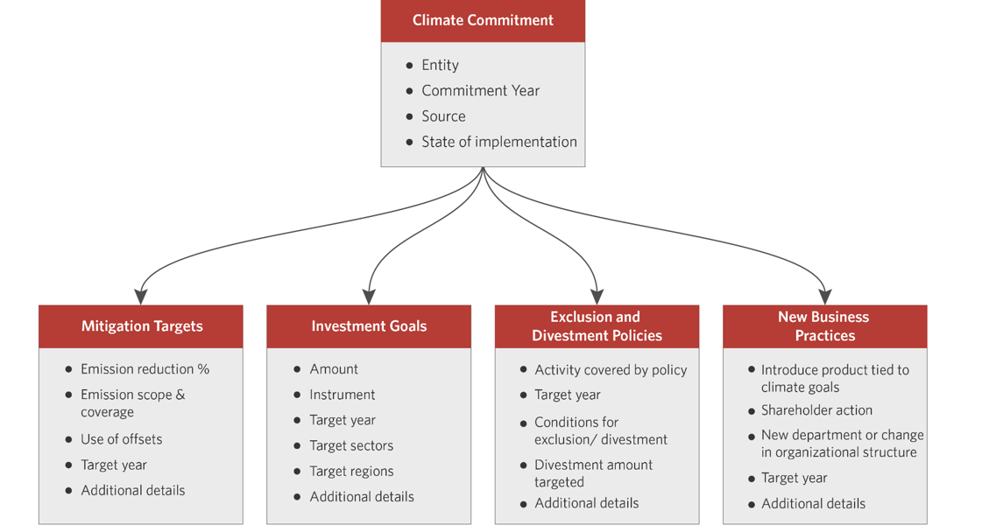
Our new taxonomy of climate commitments captures what steps institutions are taking to meet net zero goals
Notes:
Setting a net zero target is just the first step, and we wanted to capture the other climate-related announcements companies are making that may affect the real economy. To do this, we created a new taxonomy of climate commitments described on this slide. Starting from the left-hand side of the screen:
Mitigation targets, including long- and shorter-term emission reduction goals and Scope 1/2/3 coverage
Investment goals - covering companies financing projects or companies with debt and/or equity; for this category we captured target sectors and regions when available
Exclusion and divestment policies - including the specified activity or fuel and conditions for exclusion
New business practices - a bit of a miscellaneous category covering new products, shareholder actions, and organizational or governance changes
< Change Slide >

Slide 19
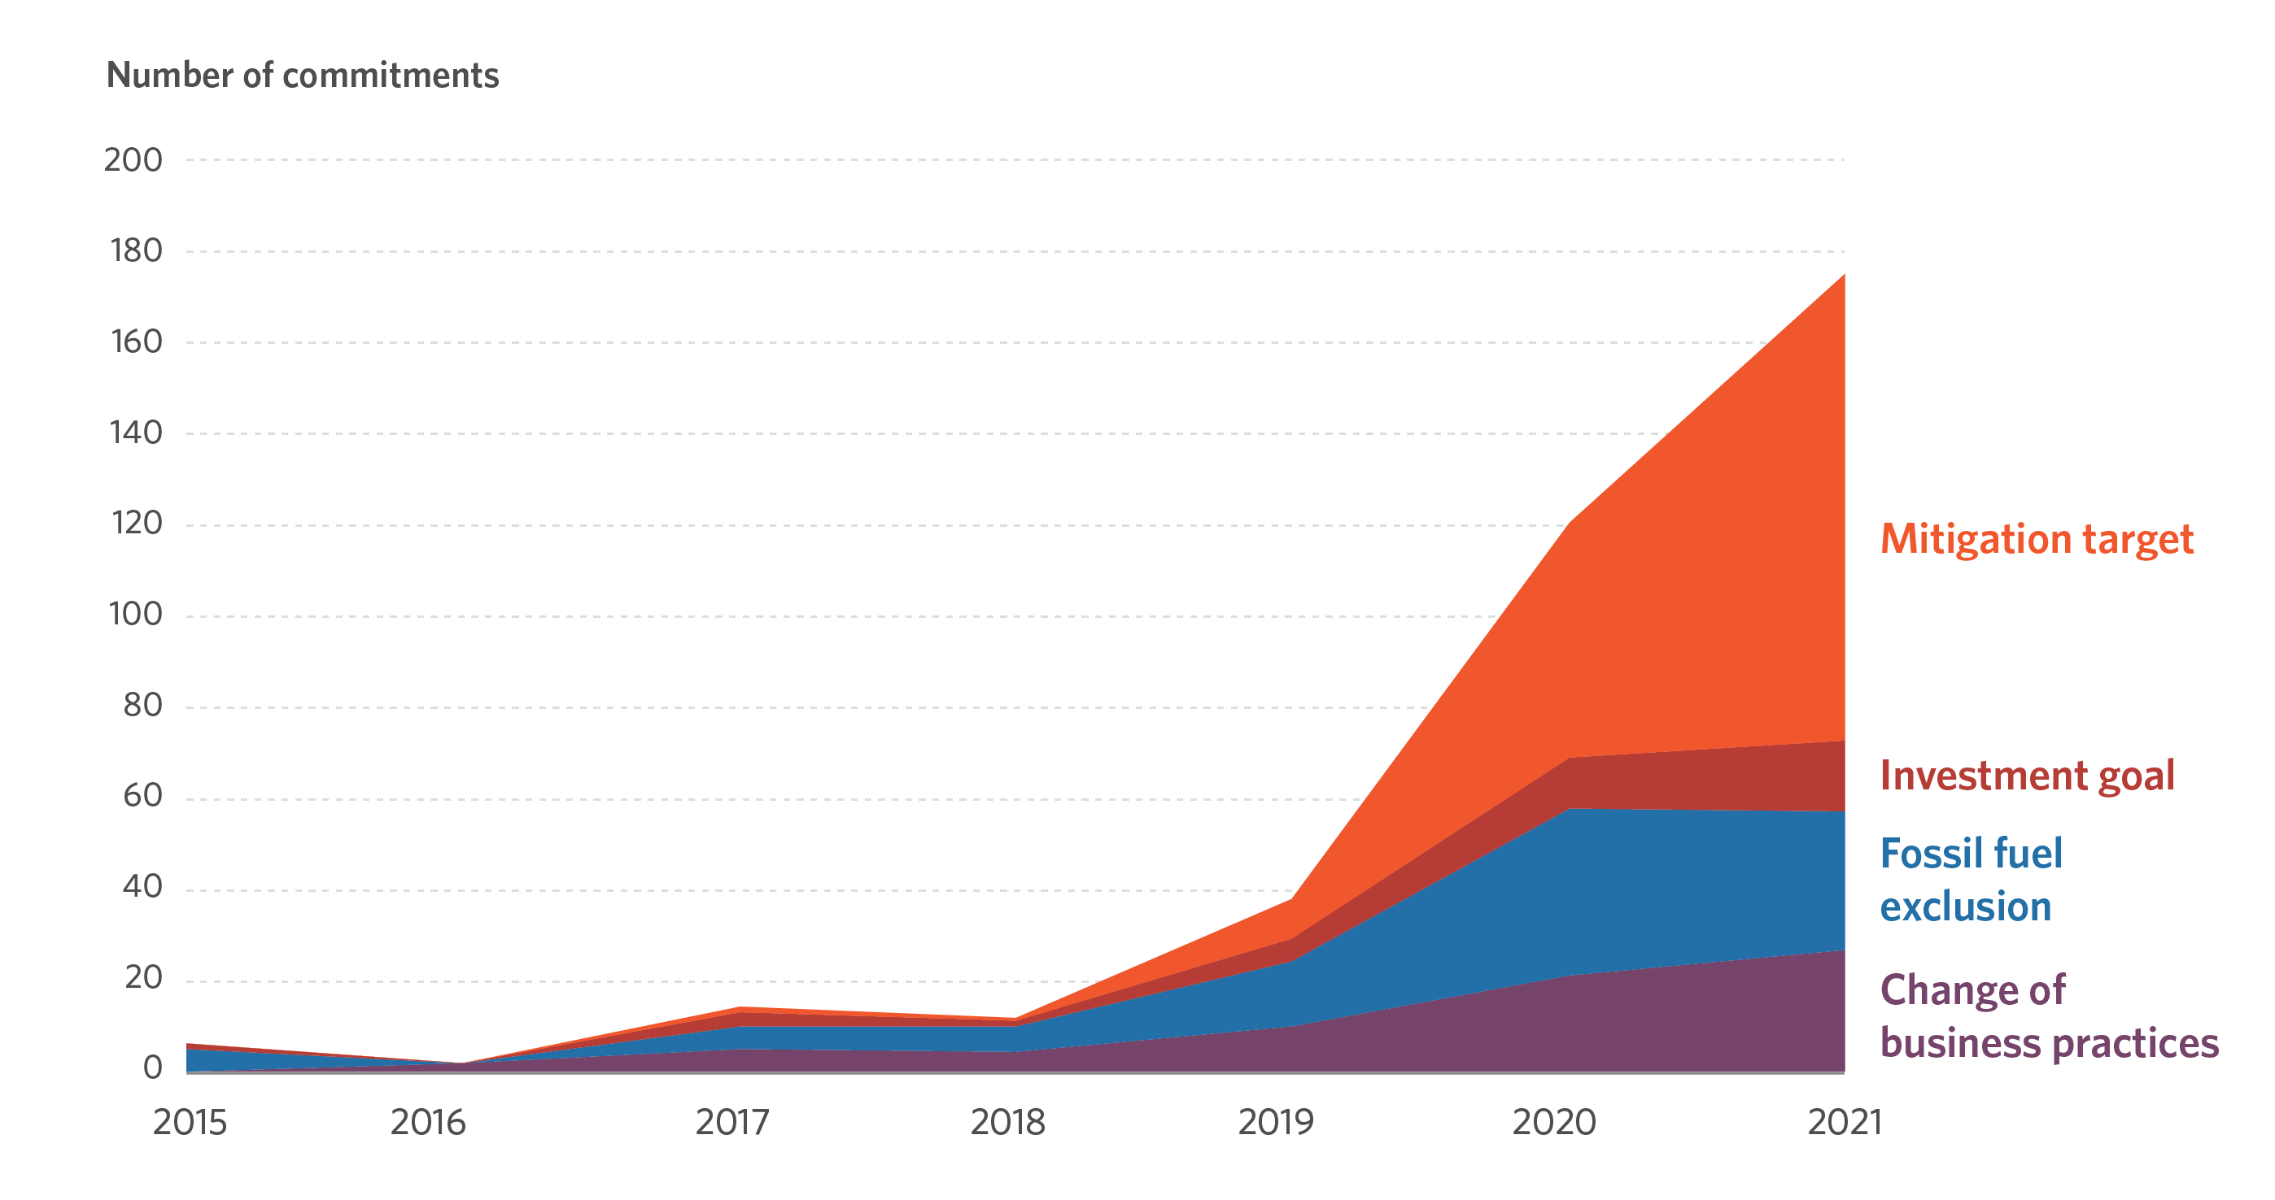
2021 brought a dramatic acceleration in financial institution climate announcements – particularly net zero targets, but more details are needed
Financial Institution Commitments By Year
Financial Institution Commitments By Year
Notes:
I’ll go into each category next, but the trend over time of these commitments is no surprise - 2021 has seen a big uptick in climate announcements, with a particular jump in mitigation targets. This is partly driven by the effort to mobilize finance in the run-up to COP26 and the results of the US election last November.
These mitigation targets are still very high level - only 12 entities so far have set interim portfolio emission targets, which are crucial for helping companies meet their long-term goals and provide a way to track progress. The net zero coalitions all require institutions to set interim targets within two years of signing on, so we anticipate this number to grow dramatically over the next year, if not before COP26.
< Change Slide >

Slide 20
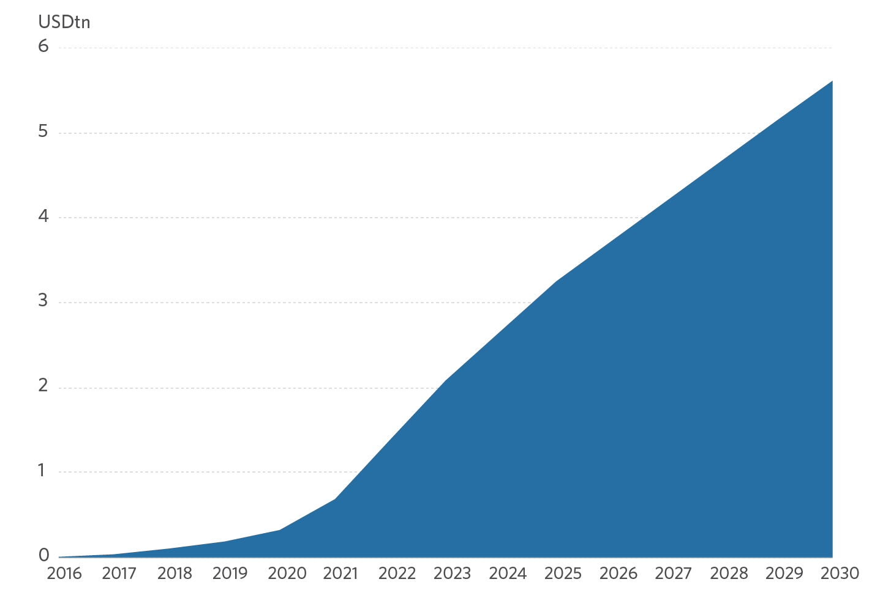
Financial institutions are raising ambition in climate investment goals, but lack specificity
Cumulative climate-earmarked investment commitments assuming linear progress
Notes:
Similarly to mitigation targets, financial institutions are dramatically raising their ambition when it comes to investment goals. It’s not uncommon now to see multi-hundred billion dollar announcements.
As you can see on this chart, we found that by 2030 financial institutions are committing to financing or investing cumulatively more than 5.5 trillion in climate solutions or green finance. While an apples-to-apples comparison is not feasible, if these goals are met by 2030 it would represent a 95% increase relative to current tracked private finance.
However, even if the topline numbers are ambitious, key details are missing. For example, more than half of the investment goals we identified are committed to a broad “green finance” category, and we only found four region-specific targets (although more recent announcements in the run-up to COP indicate a focus on mobilizing finance for developing economies).
< Change Slides >

Slide 21
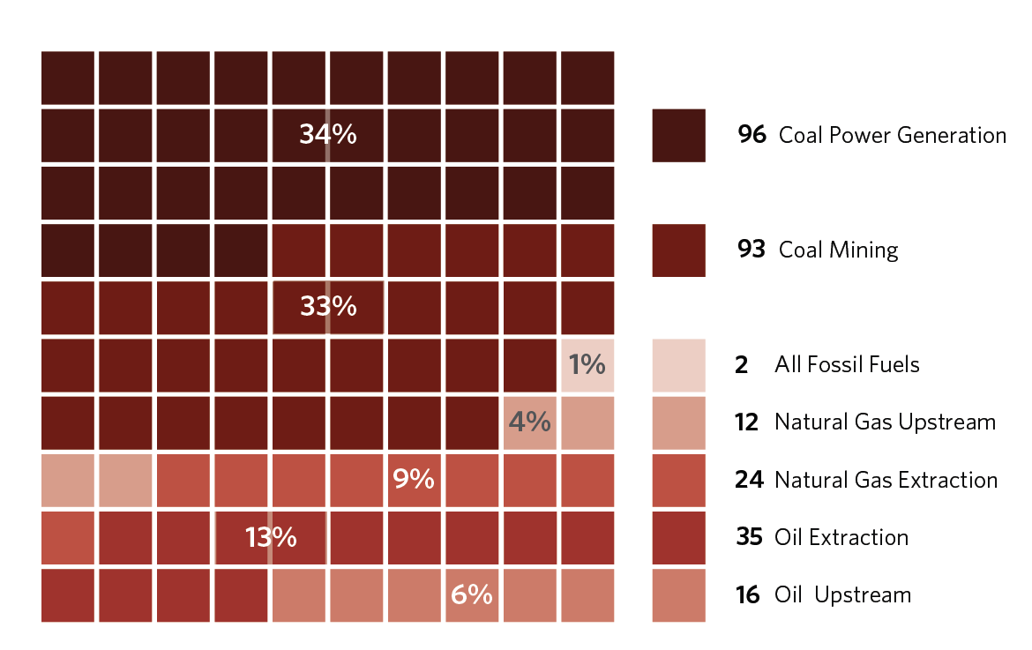
Exclusion and divestment policies are aimed at coal, and vary in their scope and stringency
Fossil fuel exclusion and divestment announcements
Notes:
Of course, increasing climate investment and financing is only part of the story - financial institutions also need to stop financing fossil fuel infrastructure and work with their portfolio companies to make credible transition plans.
Most commitments we found in this category are coal-focused, as you can see on the top of this chart, and these coal commitments vary widely in stringency.
Oil and gas exclusions are still rare, and most are focused on specific regions that have received a lot of advocacy attention like Arctic drilling or tar sands. Some institutions, like CDPQ, have drawn a line in the sand on oil and gas, which is hopefully a sign of things to come.
Most of the commitments we identified were categorized as divestment, but many allowed for the option of engaging with portfolio companies to set credible transition plans - an especially important option for index funds and other passive managers.
Before I get to recommendations, I’ll note that we captured a variety of new business practices that financial institutions are using to incorporate these climate commitments into their core business models. This sort of whole-of-institution approach will be necessary to ensure that topline goals are met.
< Change Slide >

Slide 22
Recommendations
Provide more details and standardized reporting on current commitments consistent with requirements of joining net zero alliances.
Increase ambition in top-level goals.
Bring in financial institutions which have not yet made ambitious climate commitments.
Work with policymakers to support policies that will make achieving net zero goals easier for financial institutions and portfolio companies.
Notes:
Now to our recommendations:
First, financial institutions should provide more details on goals they have already made, including reporting in a standardized way. This is required per joining net zero alliances, so we are hopeful that in a future update we will see progress on this front.
Next, institutions should of course increase ambition in their top-level goals and seek to be a leader in the industry.
One way to show leadership is to bring in financial institutions that have not yet made climate commitments and help them meet the minimum, including by helping companies set credible transition plans to both reduce emissions and improve their resilience. This is especially true for institutions in developing economies, many of whom are unable to join net zero alliances due to a lack of data availability.
Finally, financial institutions and alliances should ensure their policy lobbying is aligned with their net zero goals - policy can make it far easier for them to meet these goals, whether that’s through for example, climate risk disclosure, a price on carbon, or concessional public finance to crowd-in investments in developing economies or hard-to-abate sectors.
We provide more detailed recommendations by commitment type and for different groups of actors in our report.
With that, I’ll hand it back over to my colleague Paul who will take you through the rest of the Global Landscape.
< Change Slide >

Slide 23
Mitigation Finance
Notes:
Thank you, Matthew. Going back to the Global Landscape results, let’s now dive into the climate finance flows of the last two years to try to understand:
What climate mitigation and adaptation solutions were invested in?
Where were these investments flowing to?
With no further due, let’s jump right into mitigation finance…
<Change slides>

Slide 24
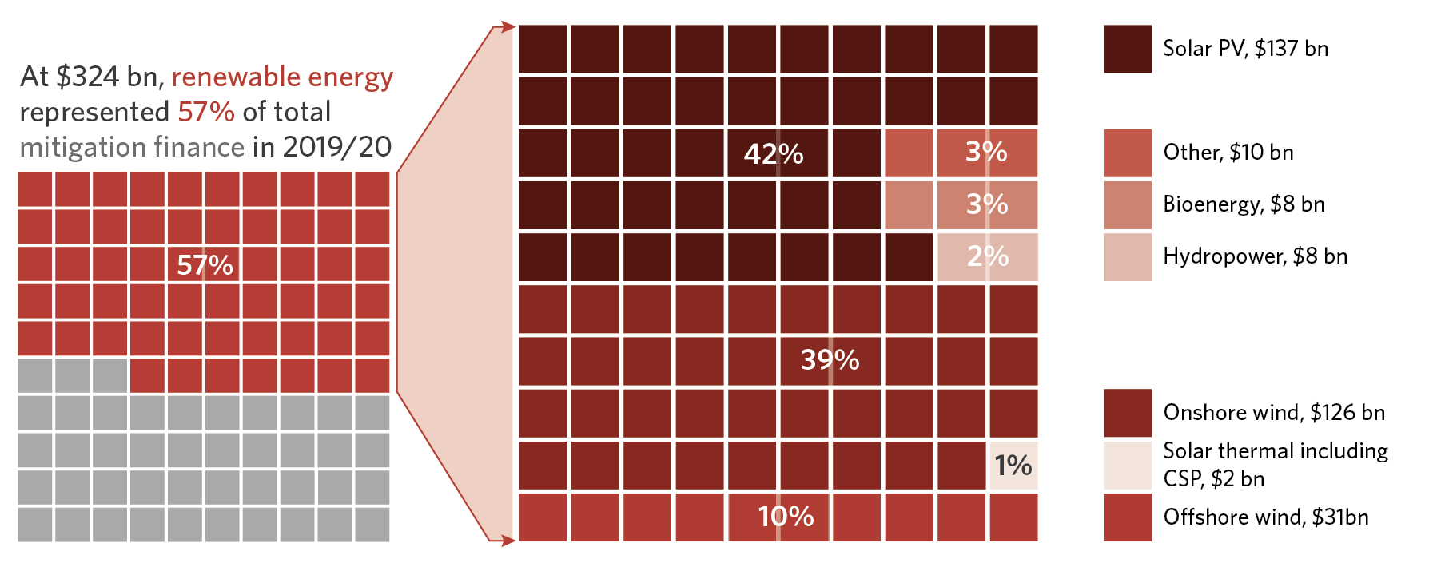
Sectors Energy supply: Renewable energy
Renewable energy remains the largest mitigation sector, with solar PV and wind attracting over 91% of investments
Renewable energy investments by sector as a share of mitigation finance (USD bn, 2019/2020 average)
Notes:
In 2019/2020, average annual investment in renewable energies reached USD 324 billion. RE represented 57% of mitigation finance tracked. It’s therefore the largest mitigation sector, by far..
Looking at specific technologies, solar PV and onshore wind continued to be the main recipients of renewable energy finance. Together, they accounted for 81% of total.
Now let’s put these numbers into perspective…
<Change slides>

Slide 25
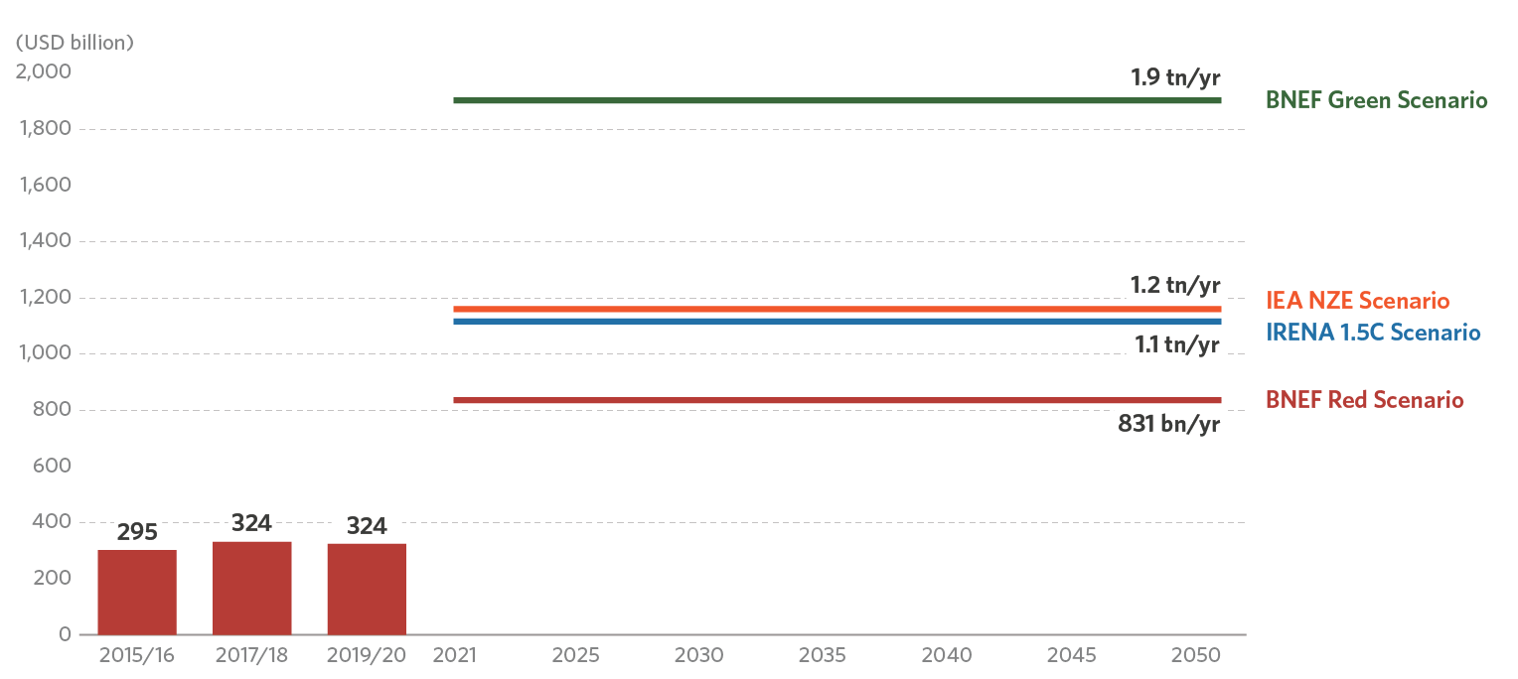
Sectors Energy supply: Renewable energy
Annual renewable energy investments need to at least triple to keep warming within 1.5° C by mid-century
Annual renewable energy investments (2015-2020) vs investment needs through 2050
Notes:
What you are looking at is:
On the left, The annual investment levels in RE from the last three landscape editions.
and from 2021 onwards: a selection of scenarios that estimate the average annual investment in RE required to keep global warming well below 2C. These scenarios come from various sources. As Baysa mentioned when discussing investment needs, each of these estimates explore a specific pathway compatible with our needs to decarbonize the energy sector. Multiple pathways or options exist. What’s important here is that no matter the scenario used as a reference, current investment levels are nowhere near being on track. This is concerning, even more so as it is difficult to read a clear and strong growth trend in recent years.
Unfolding the sources of finance is critical to understanding where the change can come from…
<Change slides>

Slide 26
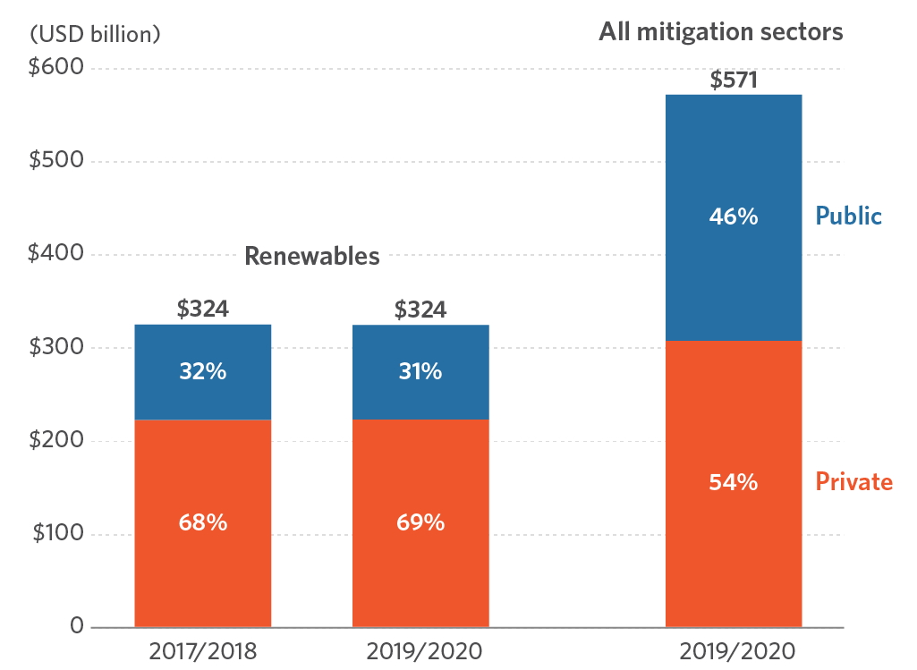
Sectors Energy supply: Renewable energy
Private sources continue to provide the majority of renewable energy finance
Investment by public/private source – renewables vs. mitigation (USD bn)
Notes:
In the last two years, the private sector provided 69% of renewable energy finance.
Renewables are generally able to attract greater shares of private finance compared to other mitigation solutions, because of their higher competitiveness - a result of their continued falling technology costs.
Among private actors, commercial FIs emerge as the main providers of finance for renewables
On the public side, State-owned FIs provided the most public finance for renewables, followed by national DFIs.
While cutting GHG emissions from our energy systems is crucial. Just as important efforts are needed in three end-use sectors which have been driving global energy demand for years: Transport, Buildings, and Industry.
<Change slides>

Slide 27
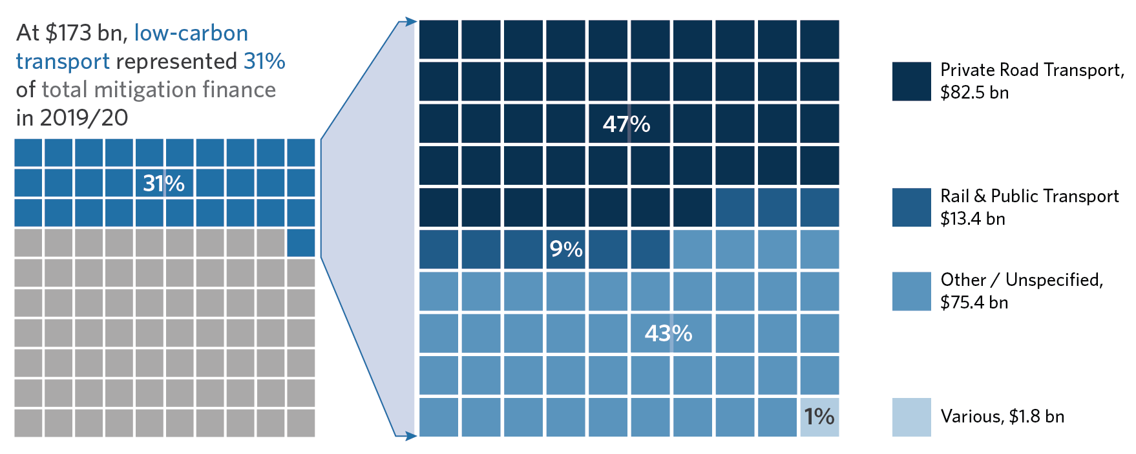
Sectors High Energy demand: Transport
Low-carbon transport is the fastest-growing sector in 2019/2020
Low-carbon transport sub-sector investment
Notes:
Decarbonizing our economy relies on their deep and complex transformation. However, mitigation strategies in these sectors rely on three common pillars: energy sobriety, energy efficiency, and low-carbon energy sources. So after renewable energy, let’s discuss mitigation investments in transport.
Mitigation finance in transport reached an all time high of USD173 billion per year in 2019/2020. It is the second-largest sector after RE but it is the fastest-growing one. (+23%)
Investment tracked to road transport (Battery electric vehicles and chargers) accounted for about half of low-carbon transport finance. Battery electric vehicle sales are growing fast - boosted by multiple years of decreasing technology costs and public subsidies.
In comparison, despite gaps, low-carbon investments in Rail & Public transport are lagging.
Additionally, a large share of the transport finance tracked came with insufficient details to be categorized further.
While tracking climate finance in transport comes with challenges, things only get harder when looking at the buildings and industry sectors.
<Change slides>

Slide 28
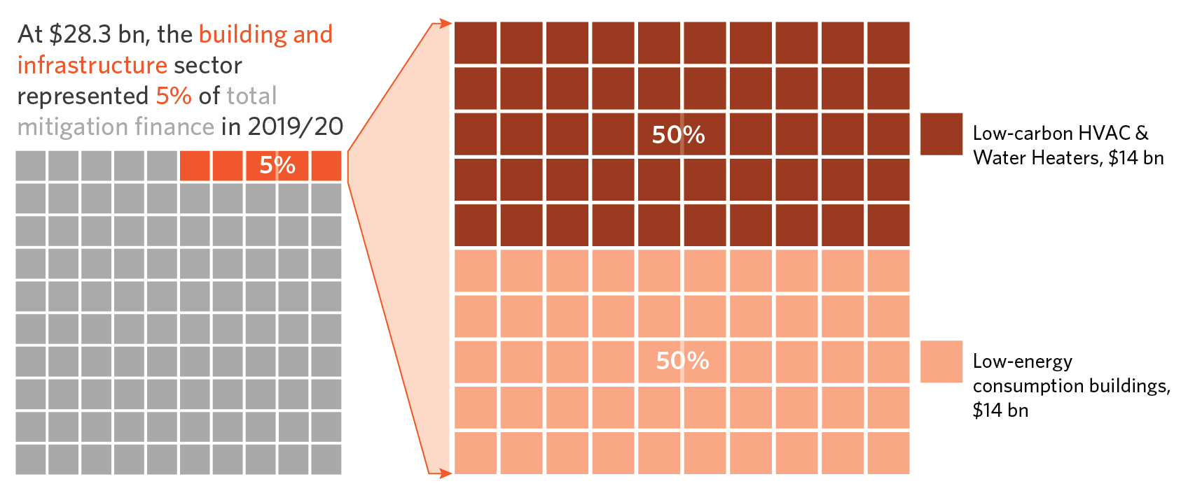
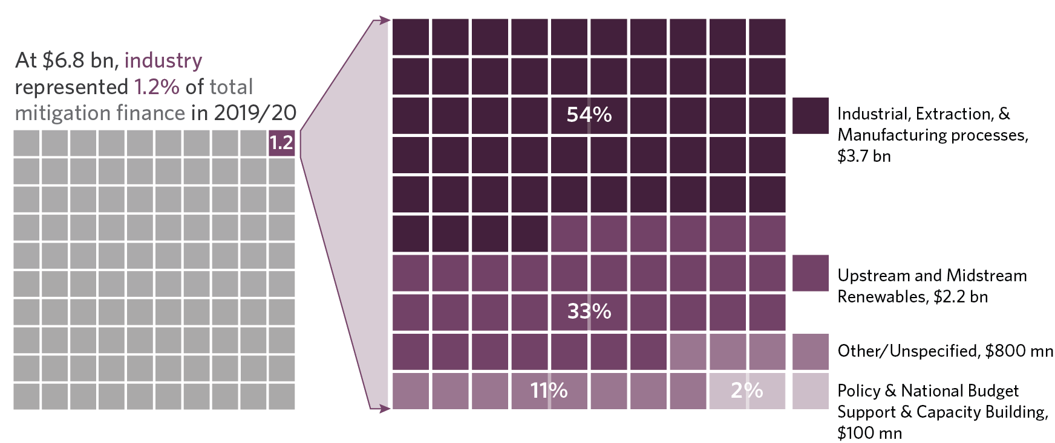
Sectors High Energy demand: Buildings & Infrastructure
Tracking Climate Finance in Buildings and in Industry hindered by poor data availability and inconsistent reporting practices
Buildings & Infrastructure: USD 28 billion
Industry: USD 7 billion
Notes:
As you can see here, mitigation finance levels in Buildings and Industry are low. There are multiple reasons why:
First, poor data availability
Second, inconsistent reporting methodologies and missing definitions:
For example, in buildings, some data providers report the full cost of low-consumption buildings, while only the incremental cost should be counted. CPI will launch a methodological brief on energy efficiency tracking in Buildings together with the full narrative report, next November.
The volume of finance we track is low. But even when using top down estimates of current investment flows, we’re far from what will be needed in the coming years. According to a range of scenarios, average investment needs in these two sectors combined sit between USD 760 billion and USD 1.5 trillion annually through 2050.
<Change slides>

Slide 29
Adaptation Finance
Notes:
Generally, efforts to mitigate global warming involve systemic changes. While their implementation is at least partly up to us, some other changes are simply beyond our grasp/control. And result in necessary actions to adapt to a changing climate. So we’ll now look at investments in adaptation to climate change.
<Change Slide>

Slide 30
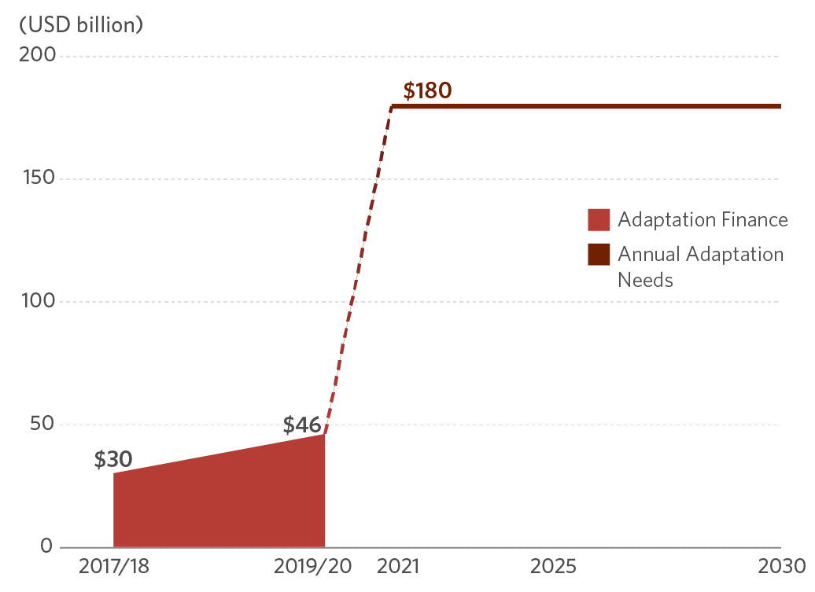
Adaptation finance gained momentum in 2019/2020 but remains well short of estimated needs
Adaptation finance and needs
Notes:
Adaptation finance gained momentum in 2019/2020, increasing by 53% compared to 2017/2018 to an annual average of USD 46 billion. This increase stems from an uptick in Water & Wastewater, and other cross-sectoral projects including disaster risk management. However, and this is pretty clear looking at this graphic, adaptation finance falls well short of estimated annual needs through to 2030.
<Change slides>

Slide 31
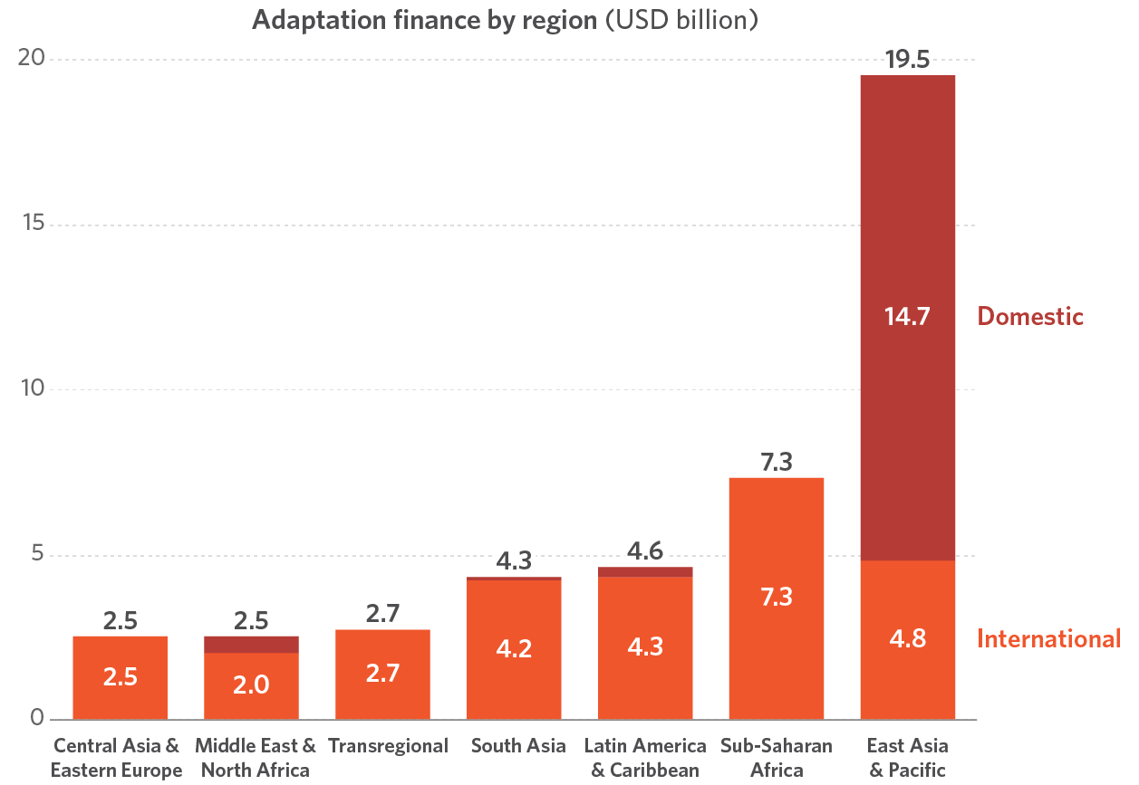
Largest recipient of international adaptation finance is Sub-Saharan Africa; East Asia & Pacific lead the way overall
Adaptation finance by region (USD bn, 2019/2020 annual average)
Notes:
The top ten most vulnerable countries to the impacts of climate change are all in Sub-Saharan Africa. The region received the greatest share of international adaptation finance (25%) at USD 7.3 billion, however, commitments are at the lower end needs estimates.
Adaptation in East Asia and Pacific is primarily financed by domestic actors. Globally, 37% of all adaptation flows are sourced domestically, but East Asia and Pacific and China especially, is accounting for the majority of those.
Public domestic
<Change slides>

Slide 32
Geographic Flows
Notes:
But East Asia and Pacific is not only concentrating adaptation finance flows. Let’s take a step back and look into the geographical breakdown of total climate finance.
<Change slides>

Slide 33
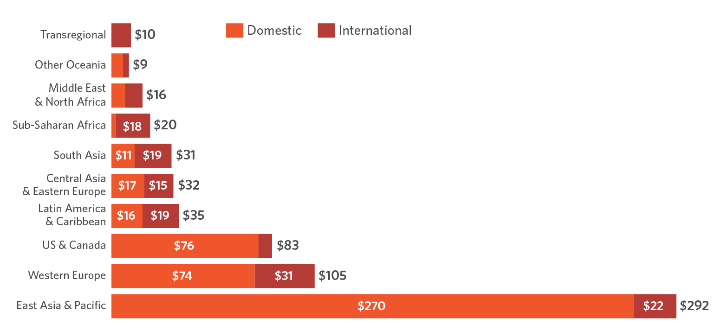
Executive summary
Climate finance flows are concentrated in East Asia and Pacific, Western Europe, and North America
Domestic and international climate finance flows by region of destination (USD bn, 2019/2020 annual average)
Notes:
Around USD 479 bn of climate investments were raised and spent within the domestic territories. The USD 153 billion of international flows grew slightly, primarily driven by increased public investments from multilateral and national DFIs.
Almost half of 2019/2020 tracked global climate investments went to East Asia & Pacific (EAP). China alone represented 81% of that amount.
<Change slides>

Slide 34
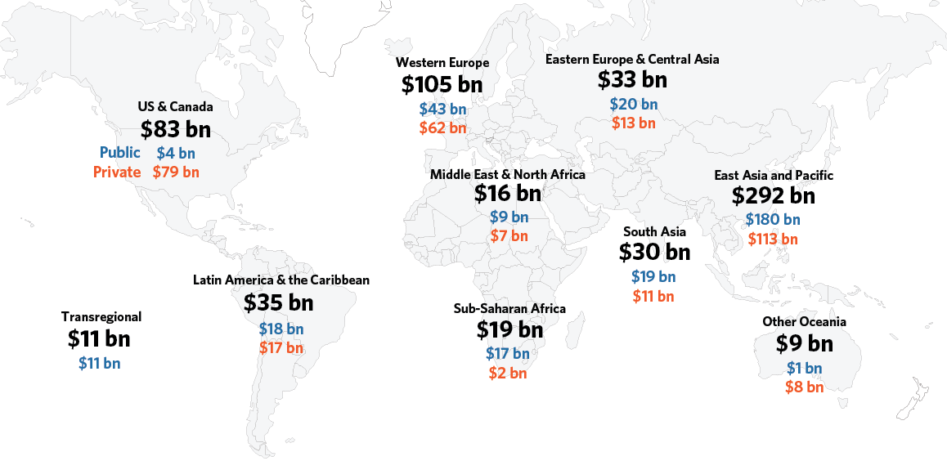
East Asia and Pacific remained the main region of destination of climate finance
Destination region of climate finance, by public/private (USD bn, 2019/2020 annual average)
Notes:
The climate projects in economically advanced regions of Western Europe, US & Canada, and Other Oceania were primarily funded by private finance, while the rest of the regions sourced their climate investments mostly from public sources. strong government support through public spending and national policies towards better investment climate
All regions were mainly funding mitigation actions, with 80% of the mitigation investments concentrated in the high emitting regions of US & Canada, Western Europe, and East Asia and Pacific.
Thank you for attention, I’ll now turn to Baysa to explore what conclusion these results lead to.
<Change slides>

Slide 35
Recommendations

Slide 36
Conclusions and key recommendations
The scale of finance must increase – this decade will make or break the transition to a sustainable, net zero world
2. Public and private actors should prioritise data on credible climate action and impact on the ground
Notes:
First: the finance should increase decisively and should count in trillions, not billions in this decade.
No sector is on track to meet the required investment levels. Annual renewable energy investments need to at least triple and adaptation finance need to increase at least five times. In doing so, private sector investment should be scaled up as fast as possible.
This can be done through enabling policies and innovative financial solutions to create bankable investment that follow the science.
Second: data on credible climate action and impact on the ground should be now prioritised.
Currently available disclosure initiatives fall short of providing standardized information on climate investment.
<Change slide>

Slide 37
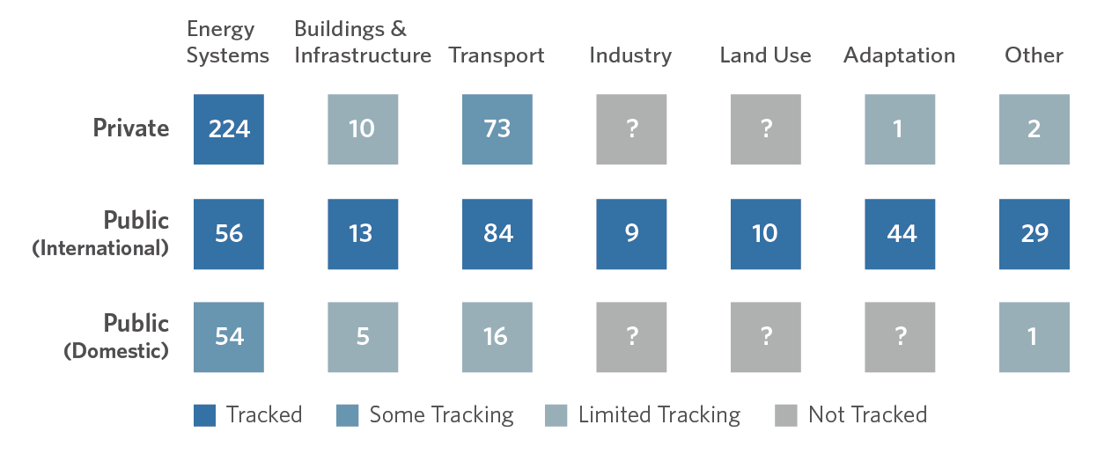
Executive summary
Data gaps and methodological issues limit our understanding of progress and impact
Figure 1.6: Data gaps in climate finance (USD bn, 2019/2020 annual average)
Notes:
Information on investment levels in adaptation, buildings, and industry sectors are scarce, particularly for the private sector, and lack shared science-based standards. This information is essential in assessing collective progress, crafting effective policies, and directing finance where it will have the most impact.
Domestic public budget expenditure on climate related activities is not universally available. This is critical information to mainstream and integrate climate framework, policies, and laws into national and sectoral budgets.
<Change slide>

Slide 38
Conclusions and key recommendations
3. We need credible Net Zero Commitments with clear transition plans, including interim goals
4. We need structural change focusing on the nexus between the environment, the economy, and the people
Notes:
Third, we call for credible and coordinated Net Zero Commitments with clear transition plans, including interim goals by public and private actors.
Public and private sectors do not have a commonly accepted definition of climate finance nor an understanding of what all financial actors should be doing at minimum. The siloed approach on the common definitions could impede the pace of change and impact on the real economy.
Coordination across silos of public and private financial actors are needed to ensure coherence and impact on net zero and sustainability, in alignment with science and with support of civil society.
Finally, we need structural changes focusing on the nexus between the environment, the economy, and the people.
The urgent ramping up of mitigation investments is imperative, particularly for developed economies, while building resilience and adaptative capacity should be the critical agenda of climate finance for all economies.
Structural changes could lead us to identify broader benefits and indicators, considering planetary and social boundaries:
─ Just transition, Real economy, Planetary and environmental boundaries.
<Change slides>

Slide 39
Questions?
Please type questions into the chat box on the lower right-hand side of the screen.
Notes:
Thank you for your attention. We will now leave some time for questions from you. Please provide your questions in the chat box function. Given the limited time available we may not answer all questions, but we’ll do our best to get through as many as possible.

Slide 40
Related Projects
Net Zero Finance Tracker
Framework for Sustainable Finance Integrity
Energizing Finance: Understanding the Landscape 2021

Slide 41
Notes:
End slide with contact & websites

