Slide 1
The Landscape of Climate Exposure for Investors
25 February 2015
Dr. Barbara Buchner, Senior Director
Dario Abramskiehn, Analyst

Slide 2
Agenda
Background
Introduction to climate exposure
Managing climate exposure
Gaps in the landscape
Next steps
Questions

Slide 3
Background

Slide 4
Who we are
CPI’s climate finance program helps decision makers who are working to ensure economic growth while protecting the climate.
We provide much-needed information on climate finance flows, apply in-depth analysis to guide decision makers on their efforts, and support innovation in finance to address investors’ needs.

Slide 5
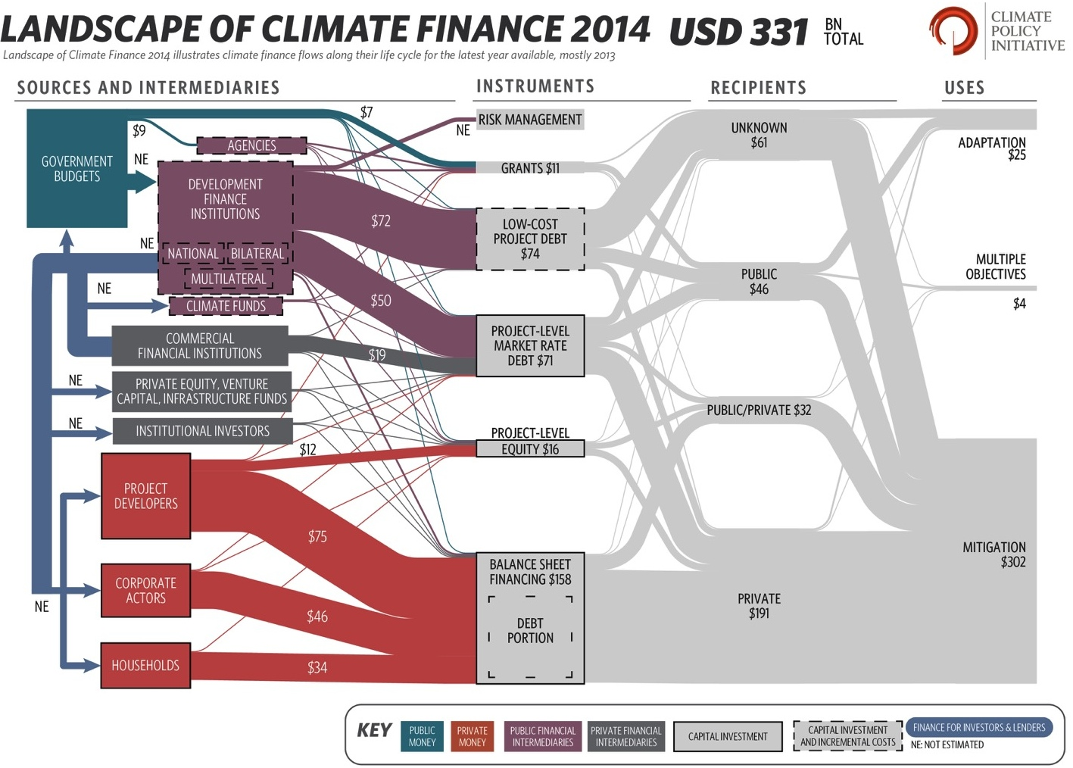
Information

Slide 6
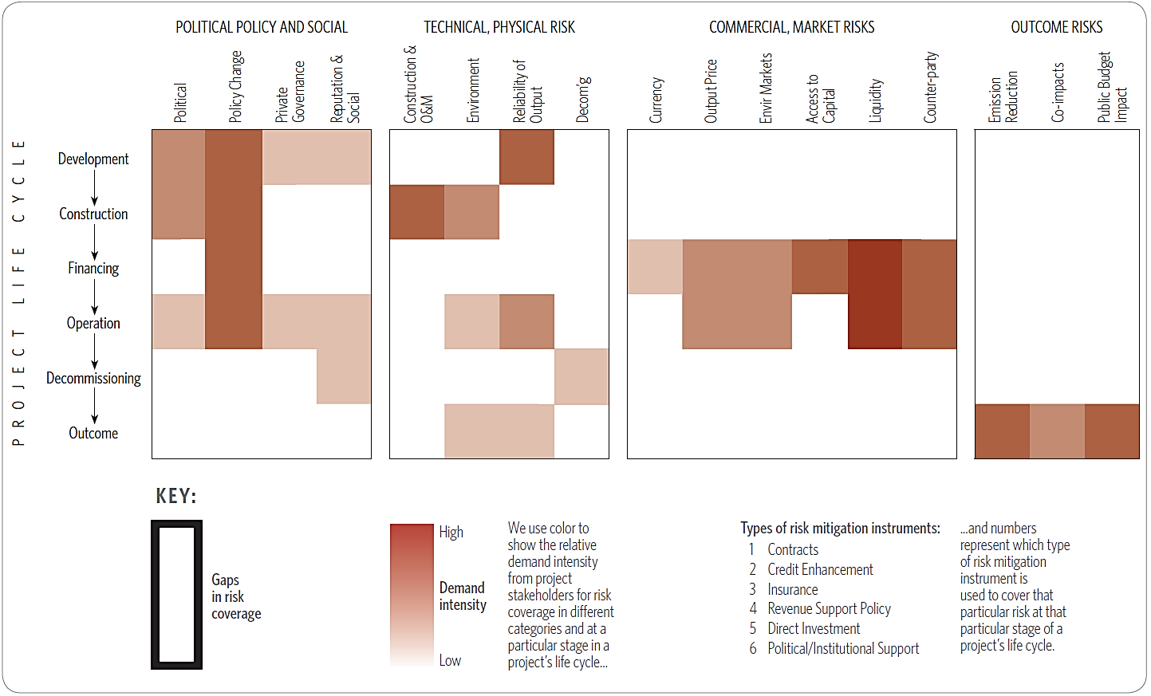
Guidance

Slide 7

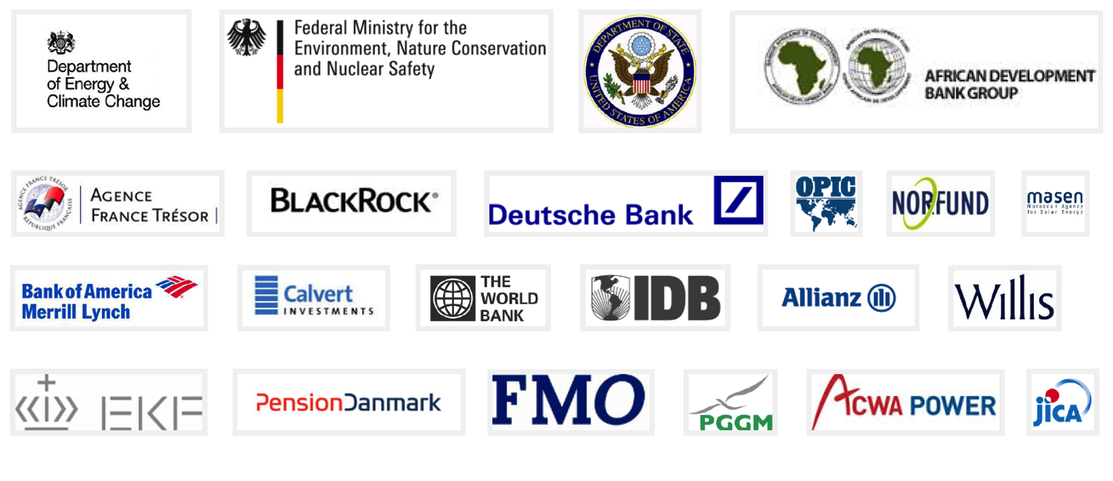
Innovation
Lab members:

Slide 8




















Project background
Interviewed Organizations:
Objectives:
Understand climate exposure landscape
Better-identify and manage climate exposure
INVESTMENT/ ASSET MANAGERS, ADVISORS, CONSULTANTS
ESG TOOL PROVIDERS
IMPACT INVESTORS
FAMILY OFFICES, PHILANTHROPIES, ENDOWMENTS
Approach:
Collaborative effort between CPI and Stanford’s Steyer-Taylor Center
22 stakeholder interviews
Tool + product investigations
Literature review
ADVOCATES AND STANDARDS-CREATORS
RESEARCH ORGANIZATIONS

Slide 9
Introduction to climate exposure

Slide 10
What is climate exposure?
Potential gains or losses in an investor’s portfolio
due to climate change
Policy and Legal Implications
Market and Economic
Effects
Physical and Ecological Impacts

Slide 11
Why does it matter?
Expected to have widespread effects on
the value of financial assets
Through…
Compliance costs
Energy costs
Commodity prices
Availability of essential resources (e.g. water, fertilizer, etc.)
Business supply chains
Existing infrastructure
Viability of business models and industries
… and so much more

Slide 12
What do experts think of climate exposure?
Often perceive or label it as “Stranded Assets” risk
Focus on short-term risks
“Primary short term risk is high-carbon asset stranding”
Longer-term risks are a concern, but less salient
Emphasize risks from policy actions and changing fuel prices
Less emphasis on how the physical impacts of climate change are affecting and will affect portfolios
Focus on “brown” downside risks
Harder to pursue “green” side and opportunities in a strategic way
Perceive this as a “definitionally-challenged, metric-challenged space”
Terminology isn’t universal; metrics are preliminary

Slide 13
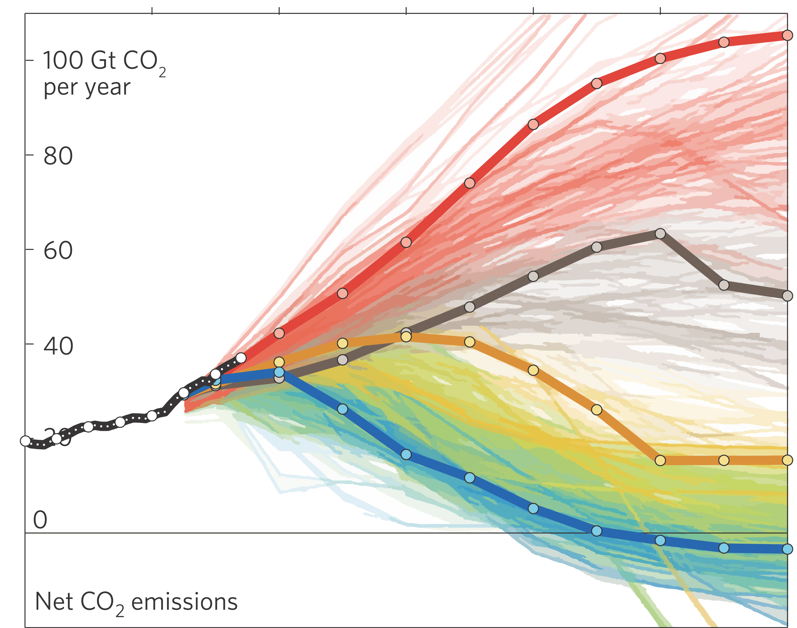
Why is climate exposure difficult to manage?
Timelines misaligned between
financial markets and climate change
2000
2020
2040
2060
2080
2100
[…]
2200
[…]
2300
3.2-5.4 °C
Physical and Ecological Impacts
Policy and Legal Implications
2.0-3.7 °C
Investment Risk Management
1.7-3.2 °C
0.9-2.3 °C
Adapted from Fuss et al. (2014)

Slide 14
Managing climate exposure

Slide 15
Framework for managing climate exposure
Minimize “Brown” investments | Maximize “Green” investments
Decrease and offset exposure to “dirty” investments to avoid… Stranded assets Volatile commodity prices Use ESG tools to hedge against investments affected by physical/ecological risks like… Food & beverages Fishing Ski industry | Increase investments that aid mitigation efforts to… Capture tech innovation Reduce volatility Integrate pro-climate financial products to allocate capital towards adaptation investments such as… Infrastructure improvements Agricultural engineering
…what influencing mechanisms, methods, tools, & financial products underlie this framework?

Slide 16
Minimize “Brown” capital
Maximize “Green” capital
Influencing Mechanism
Shareholder engagement
Pro-climate deployment of capital
Divestment
Investing Methods
Environmental, Social, and Governance (ESG) Integration
Socially Responsible Investing (SRI)
Thematic or
Impact Investing
(risk- and return- based screens)
(exclusionary screens)
Software Tools
Flagship ESG/ SRI Tools
Bloomberg ESG • TruCost • MSCI • Sustainalytics
Financial Products
• Thematic Indexes**
• Low Carbon Indexes
• Low Carbon ETFs
• Stranded Asset Total Return Swaps
• Green Bonds**
• SRI funds
• Fossil Free Indexes
• Bespoke impact investment products
• YieldCos

Slide 17
Where do ESG tools and financial products fit into the landscape of climate exposure?
Company disclosure orgs
(CDP, IIRC, GRI)
Standard-setting
(SASB, GBP)
Investor reporting, standards, and advocacy orgs
(PRI, GIIN, INCR)
Information intermediaries:
Ratings agencies
Analysts
Financial regulators
Voluntary
Voluntary
Mandatory
Investors
& Asset Managers
Companies
FINANCIAL PRODUCTS
e.g. “Fossil Free Indexes-US”
Voluntary
ESG SW TOOLS
e.g. “MSCI ESG Manager”
KEY
Tool providers
(MSCI, Sustainalytics)
Financial product providers
(MSCI, S&P DJI)
Climate exposure data & products

Slide 18
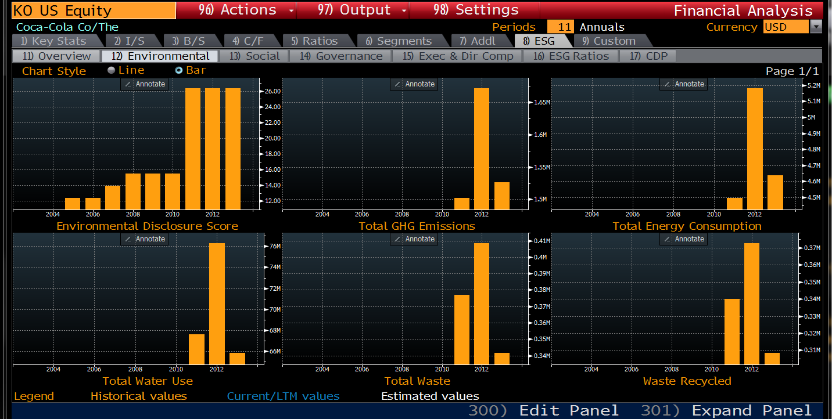


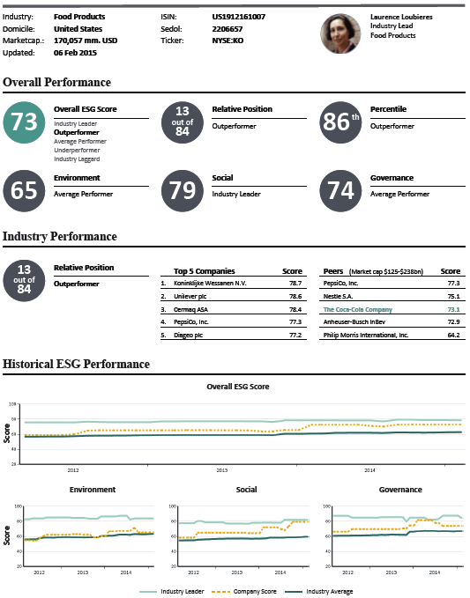
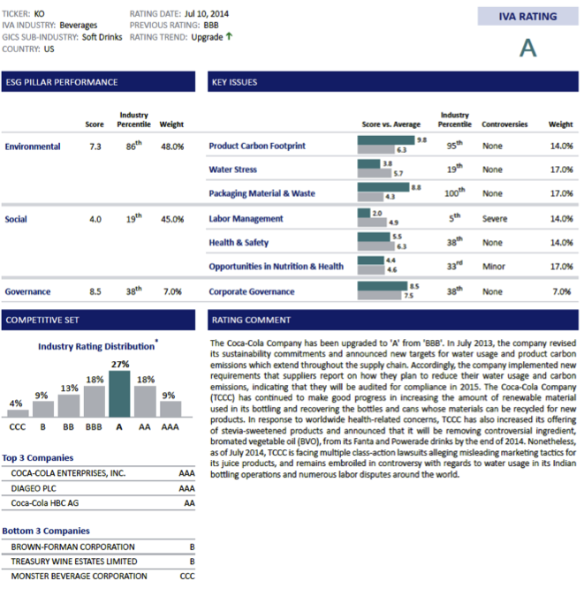

Slide 19
Software vs. Financial Products
ESG/SRI Software | ESG/SRI/Thematic Financial Products
“Do-It-Yourself”: Data + analytical tools supporting active, bespoke ESG/SRI investment strategies Common Functions: Carbon footprinting Water intensity Energy intensity ESG reading/screening/rating Portfolio analysis | “Pre-packaged” products: Maximize returns given climate risks and opportunities Rely on industry expertise Align to the 3 major investment methods Non-exclusionary (e.g. low-carbon indexes) Exclusionary (e.g. fossil free indexes) Thematic (e.g., green bonds)
Examples … Bloomberg (ESG Suite) MSCI (ESG Manager) Sustainalytics (Industry Reports) TruCost (Eboard) | Examples … Fossil Free Index US MSCI Global Climate Index STOXX Global ESG Leaders S&P Green Bond Index family

Slide 20
Software tools are useful but have some gaps
 | Particularly helpful for.. | Comments
Bloomberg ESG Suite | Mainstream asset managers who already use Bloomberg products | Aggregates all publicly-available ESG data, plus proprietary data from other ESG providers (e.g., Sustainalytics) | Challenging UI and predominantly a data aggregator (vs. enhancers)
MSCI ESG Manager | ESG experts looking for as much information as possible | Granularity and rigor of data is widely lauded; tons of functionality available | Can be overwhelming; huge taxonomies of “E” data for typical investors
Sustainalytics ESG Tools | ESG-inclined investors who mainly want relative data | Tracks and assesses companies by scores, allowing for easy ranking and juxtaposition | Emphasizes relative scores (as opposed to raw data)
TruCost Eboard | Smaller investors/asset managers looking for data completeness | Experts estimate non-disclosed values, enhancing data completeness and comparability | Less comprehensive functionality and more ‘locked-down’ data

Slide 21
Financial products are competitive vs. benchmarks, but not fully transparent
 | Particularly helpful for.. | Comments
Exclusionary Fossil Free Indexes US | Investors who want to divest completely from major fossil fuel companies | Divestment of CU200 historically comparable to S&P500, and currently slightly outperforming | Decreases portfolio diversity with loss of CU200 companies
Non-Exclusionary STOXX Global ESG Leaders | Those looking to invest in the cleanest players in a dirty space | 2002 historical performance would’ve nearly quadrupled in value, relative to doubling of STOXX Global 1800 | Still exposed to fossil fuel volatility and stranded asset risk
Thematic MSCI Global Climate Index | Investors looking for upside opportunities in the “green capital” space | Performance comparable to benchmark MSCI World performance | Subject to some green marketing: index holdings are not predominantly RE, EE, or cleantech
Thematic S&P Green Bond Index & Green Project Bond Index | ESG- or thematic-inclined investors looking for fixed income opportunities | GBI goes beyond GBP labelling standards; GBPI significantly outperformed benchmarks | GBI is immature (mean is ~6 yrs); benchmarking is preliminary for both, and liquidity is overemphasized

Slide 22
Software & financial products are both important for managing climate exposure
 | + | -
ESG/ SRI Software Tools | Aggregation Analysis Entire portfolio | Brown emphasis Labor intensive Data integrity Operationalization Strategy
ESG/ SRI/ Thematic Financial Products | Strong performance vs. benchmarks Less labor | “Green” marketing “Green” asset-class diversity Impact transparency Emphasize “G” in ESG Limited financial history

Slide 23
Gaps in the landscape

Slide 24
Gaps in the climate exposure landscape
ESG tools and financial products
Minimize “brown” exposure
Powerful, maturing - but with limitations
Can be incorporated into strategies today
“Green” (mitigation/adaptation) financial products
Smaller segment, less mature, less asset class diversity
Strong early performance, but often overstate climate relevance
Underlying data
Public-equity heavy; significant self-reporting
Limited physical/ecological risks data (e.g., water, infrastructure)
Standard-setting and disclosure initiatives
Lack decision-driving influence -- power through public- and investor- pressure
Critical role in shaping maturing disclosure standards today

Slide 25
Next Steps

Slide 26
Capitalizing on climate investment opportunities
1.
Design a strategy to minimize your “brown” climate risk exposure
2.
Explore available “green” financial products to hedge investments against risk
3.
Establish a group of like-minded investors to engage in an interactive process of evaluating portfolios on a regular basis

Slide 27
Thank you!

