Slide 1
A comparison of renewable and fossil fuel based power in India
Dr. Gireesh Shrimali, PhD
Director Climate Policy Initiative India

Slide 2
Risk perception and financial performance
Notes:
This is part of a larger work, covering multiple aspects of renewable and fossil energy companies/projects
This particular study seeks to study the historical and present-day financial performance and risk profile of the renewable energy and fossil fuel power sectors, with a view to informing the decisions of investors and policymakers by answering questions such as:
How have the renewable energy and fossil fuel power sectors fared financially in the past with respect to the risk and risk-adjusted returns exhibited?
How does investors’ risk perception of the renewable energy and fossil fuel power sectors differ?
What factors contribute to the differing risk perceptions of the renewable energy and fossil fuel power sectors?
We answer these questions using two approaches:
Ex post empirical analysis of financial performance data of listed equity of power producing companies
Primary research with direct investors (in unlisted equity and debt) in the sector to understand their perceptions of the risk and the areas of concern.

Slide 3
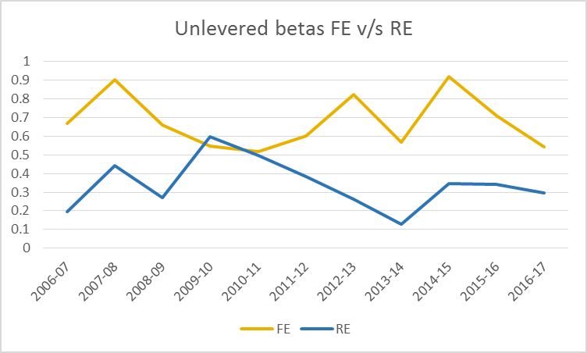
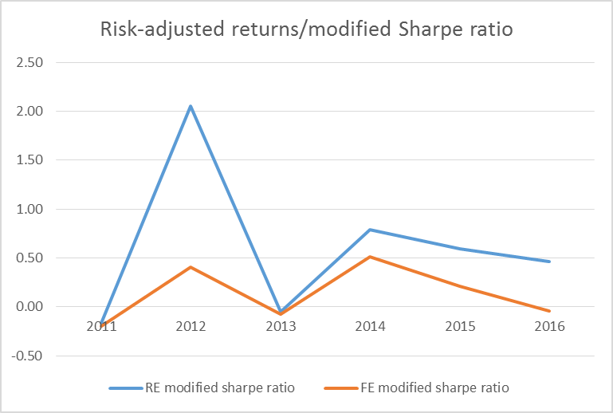
Risk & returns: Historical analysis of listed equity
The renewable energy power sector has been less risky than the fossil fuel power sector. The listed renewable energy power sector has historically exhibited, ex post, approx. half (47%) as much systematic risk as the listed fossil fuel power sector.
Renewable energy power has been a more lucrative investment than fossil fuel power. Renewable energy power portfolios have historically shown more attractive investment characteristics including, on average, 12% higher annual returns, 20% lower annual volatility, and 61% higher risk-adjusted returns.
Returns for both renewable energy and fossil fuel power companies are robustly correlated with the market returns. Using econometric methods, We were unable to determine whether others relevant factors such as company size, value, leverage, coal prices, rupee exchange rate and term premium are robustly priced into the stock returns.
Figure 1: Unlevered betas for the Renewable and Fossil Fuels power sectors
Figure 2: Historical variation of Sharpe ratio for the Renewable IPP and Fossil Fuel IPP indices
Notes:
? The unlevered beta is right to left
A) Changed the figure.
? The Sharpe ratio converges many times and to zero/negative
A) We have used the modified Sharpe ratio here. The Sharpe ratio fails in cases where the excess returns are negative. The modified sharpe ratio is given by (excess returns)/(volatility)^sign(excess returns). For these years too, the risk adjusted returns of the RE portfolio are better than for FE portfolio.
A set of 23 companies has been chosen for the analysis – this includes 11 conventional/fossil fuel energy power producers and 12 renewable energy power producers.
We looked at unlevered beta (systematic risk), annual returns/volatility, and Sharpe Ratios (return/volatility)
The beta jump in 2009-2010 is due to the uncertainty around policy (AD, GBI) for wind, the dominant source of RE power then (>75%).

Slide 4
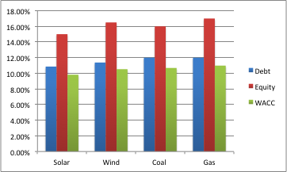
Risk & returns: Investor perception of unlisted debt/equity
Investors perceive renewable energy power investments to be less risky than fossil fuel power investments too. The expected returns on debt to the fossil fuel power sector is at least 80 basis points (bps) higher than the renewable energy power sector.
Within the renewable energy power sector, solar is perceived as less risky than wind. This may be due to the higher perceived resource risk for wind power over solar power
In the fossil fuel power sector, coal is perceived as less risky than natural gas. This may be due to the higher market risk associated with natural gas based power due to insufficient domestic reserves, import dependence, high global prices and lack of transport infrastructure in India.
The main risk factors driving the risk perception of both the sectors are common i.e. counterparty, grid, and financial risks. These risks together account for 50% - 54% of the total risk premium. Further, for the fossil fuel power sector, the resource risk and power market risk are also significant, contributing to 26% of the total risk premium.
Figure 3: Expected rates of return on debt and equity and the expected weighted average cost of capital for a typical project
Notes:
We reached out to a long list of 76 potential investor interviewees. Out of the interviewees that responded, 16 complete responses to the structured interview were considered towards deriving the results for this section.
The idea was to calculate not only risk premium but also the components of risk premium by asking: probability of the risk and impact of the risk, leading to the expected impact of the risk, which was then normalized

Slide 5
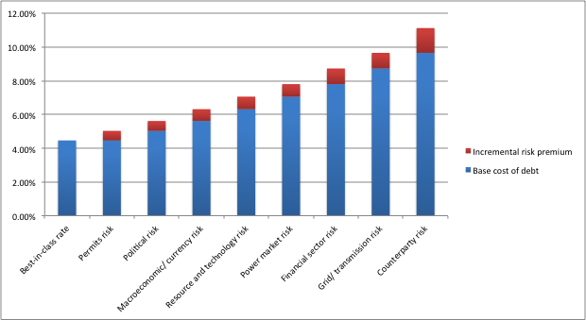
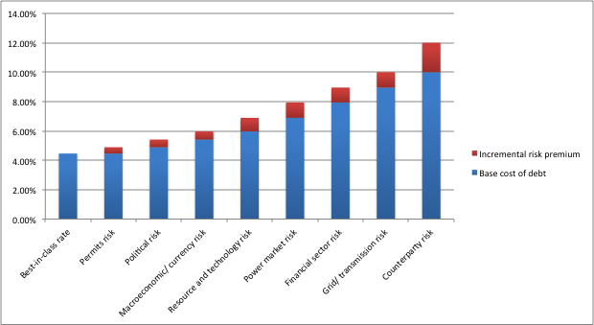
Risk factors: Investor perception
Counterparty risk is the most significant risk. Counterparty risk, related to DISCOM non-payment is the most significant risk, contributing to approx. one quarter (22-27%) of the risk premium for renewable and fossil fuel energy
The grid/transmission risk contributes 14% to the risk premium for both sectors. This risk pertains to the inadequacy of the transmission infrastructure to absorb the electricity capable of being generated by the installed capacity.
The financial sector risk, related to the inability of project sponsors to access sufficient equity and debt capital, is the third major driver of risk.
Figure 4: Debt financing waterfall for renewable energy power sector
Figure 5: Debt financing waterfall for fossil fuel power sector
Figure xx: Debt waterfall for conventional energy
Figure xx: Debt waterfall for renewable energy
Notes:
? Base cost of debt is less than 5%
A) This is calculated by adding India country premium 2.66% to the best in class (Germany) 1.8%. So, essentially, in USD!

Slide 6
Managing renewable energy integration through flexible coal
Notes:
Scope
Increased flexibility requirements in case of high RE penetration
Impact of high RE penetration on PLF of coal based power plants
How converting baseload coal capacities into flexible reserves can be useful in short term
Economic cost of conversion of baseload coal plant into a flexible coal plant
Suitable mechanism to promote conversion of coal capacity to flexible capacities
Methodology
Non-Event based reserve requirements (Load Following reserve and Regulating Reserve) established using Net Load Analysis.
Using cost based cashflow model arrive at the economic cost of converting baseload coal plant to a flexible plant incorporating Retrofitting Capex cost, OPEX cost, cost of fuel inefficiency due to reduced Plant Load Factor (PLF) and loss in expected ROE due to reduced project life.

Slide 7
Managing renewable energy will require increased flexibility in the system
GWh
Following Reserves
  We plotted the load curves for 2017, 2022 and 2027.
  We established ramp up/down rates using the net load method.
  The largest ramping requirement is during 17:00 hours to 19:00 hours
  In 2017 ramping up requirement is 13.27 GW
  By 2027 the ramping requirement would be 75.05GW
Regulating reserves can be calculated using statistical properties of the net load curve
Event base reserves would need simulations, such as in ETC
Hours→
GWh
Hours→
GWh
Hours→
Notes:
RE generation fluctuates in predictable as well as unpredictable manner, making short-to-mid-term operation of a grid challenging. Further, seasonal variability of renewables makes long-term planning difficult.
A portfolio of flexible options would be required for a cost-effective solution to meet five types of flexibility needs: Spinning and short-term reserves, load following, ramping, daily balancing and seasonal balancing.

Slide 8
A complicating issue is the likely stranding of coal based plants.
Most of the coal-based units in 2017 are operating at an average plant load factor (PLF) of ~61%; this may fall to ~50% by 2022.
Since a coal plant becomes economically unviable (i.e. stranded) at a PLF of 52%, at least 1/3rd of the installed coal capacity is likely to be stranded during 2017-2027.
Notes:
? Why is coal plant economically unviable at 52% PLF, when it is designed for 85% PLF; shouldn’t it be unviable below 85% PLF
A) The tariff comprise of two types of costs: project cost (depreciation, interest cost, OPEX, fuel cost) and profit (ROE). At 85% PLF, both these cost are easily covered. When the PLF reduces, the ROE recovery starts reducing but cost is still recovered – this scenario continues till the PLF reaches 52% (this is case dependent on size and type of coal plant) as per our model assumptions. When the PLF goes below 52%, the project is not even able to recover the cost and hence project IRR becomes unviable (less than WACC).
? How is the 332GW calculated, starting from current capacity of 190GW; even with the 50GW of under-construction plants this is 240GW?
The coal based capacity addition during 2011 to 2017 was 10.16%. Based on this CAGR the expected capacity is ~245 GW in 2022. We then used a CAGR of 5% which is half of the CAGR we had seen in the earlier period 2011-2017(considering more emphasis on RE than coal) to arrive at expected capacity by 2027. this is 332 GW. This comprises the 50 GW plants under construction as well. In between CEA had th plan of retiring 72 GW of coal based capacity dur to non-conformity to environmental norms, in the base scenario we didn’t consider this.
As an alternative scenario IF the 72 GW capacity is actually retired (which doesn’t seem very probable now sicne all the investors are contesting it) the resulting capacity in 2027 would be approx. ~ 260 GW
? How is the % stranded plants calculated? What are the remaining plants assuming to run at (85%)?
A) We arrived at the total electric energy requirement for 2022 and 2027 based on the numbers provided by CEA in their draft national electricity plan. Assuming that all the installed capacity is running at max PLF this energy would be supplied in each year by coal plants lesser than the installed capacity as compared to total installed capacity Graph light grey is total installed and dark grey is expected stranded capacity considering that remaining plants are being utilized fully.

Slide 9
Cost (NPV) Implications to convert a baseload coal plant into a flexible coal plant
The additional cost of converting a baseload coal plant into a flexible plant can be in the range of 4.5%-10%* of the total project cost (NPV) of the baseload coal plant:
Technical upgradation can increase capital expenditure by up to 24% of benchmark fixed cost
Modified operational expenses and maintenance to perform flexible operations can increase fixed cost by up to 0.80%.
Reduced life due to flexible operation will lead to loss of return on equity which will increase the fixed cost.
Lower plant load factors can increase variable cost by up to 9.5% of levelized variable costs.
Notes:
? NPV are time zero or at time of flexibility; the latter is assumed in the paper
A)
ST: Corrected now. NPVs are at the time when the flexibility year which we have assumed 12th year in our analysis. The reason to assume 12th year is that typically an infrastructure project pays off its initial debt capital (capex debt) by 10-12 years under normal economic scenarios.
? Why a 25% increase in fixed cost and 4% increase in variable cost results in only 11% increase in total
A)
ST: Numbers (and graph) is updated. It is a weighted of % incremental fixed cost and % incremental variable cost.
The incremental costs mentioned are the upper bound numbers based on the assumptions used for input parameters shown in the backup slide.
NPVs are at the time when the flexibility year which we have assumed 12th year in our analysis. The reason to assume 12th year is that typically an infrastructure project pays off its initial debt capital (capex debt) by 10-12 years under normal economic scenarios.
The first 2 left most column incremental costs are shown in comparison with fixed and variable cost of baseload plant while the rightmost column is the total incremental cost in comparison with the total of fixed and variable cost i.e. total project cost.
Rationale of the Approach used:
There can be couple of approaches to compute the compensation required to achieve a commercially viable conversion of a baseload plant to flexible operations plant; cost based approach and the market pricing approach.
Since in India, only ~10% the energy is transacted using active market mechanism, this renders market mechanism relatively very weak as compared to long term contracting arrangements which generally are dependent on cost based approach. We have therefore adopted the cost based approach for computing the compensation required for converting baseload coal plant into a flexible operation plant.

Slide 10
Thank you

Slide 11
Backup slides

Slide 12
Risk & returns: Historical analysis of listed equity (Methodology)
Market-cap weighted, annual adjusted indices created for listed equity in the Renewable IPP and Fossil Fuel IPP sectors, using the MSCI Global Industrial Classification System for classification.
According to the GICS classification system, companies with predominantly renewable-based portfolios were categorized as belonging to the Renewable index, and those with primarily conventional energy based portfolios (including hydro) were categorized in the Fossils index
As per the Capital Asset Pricing Model approach, unlevered beta of these indices was treated as metric for systematic risk, and compared for the period 2006-2016
Sharpe Ratio* (ratio of excess returns over the market returns to the portfolio volatility) was used as a metric for comparing the risk-adjusted returns of these two portfolios
*In practice, we compared the Modified Sharpe Ratio to account for years with negative excess returns

Slide 13
Risk & returns: Historical analysis of listed equity (Methodology)
Predominantly Fossil Fuel Based Power |  | Predominantly Renewable Energy Based Power
Company Name | Market Capitalization 2017 (USDmm, Historical rate) | Company Name | Market Capitalization 2017 (USDmm, Historical rate)
Adani Power Limited | 2,261.7 | Advance Metering Technology Limited | 6.1
Elango Industries Limited | 0.2 | Entegra Limited | 8.9
Gujarat Industries Power Company Limited | 237.9 | Globus Power Generation Limited | 34.2
JSW Energy Limited | 1,555.9 | Ind Renewable Energy Limited | 0.7
NLC India Limited | 2,435.8 | Indowind Energy Limited | 5.7
NTPC Limited | 20,006.8 | K.P. Energy Limited | 19.1
RattanIndia Infrastructure Limited | 68.5 | Karma Energy Limited | 7.4
RattanIndia Power Limited | 318.3 | Kintech Renewables Limited | -
Reliance Power Limited | 2,004.4 | Morgan Ventures Limited | 1.8
Suryachakra Power Corporation Limited | 5.1 | Orient Green Power Company Limited | 112.5
Tata Power | 3,765.0 | S. E. Power Limited | 8.0
 |  | Sun Source (India) Limited | 0.7
Table 1: Listed independent power producers in India as of May, 2017

Slide 14
Risk factors: Investor perception (Methodology)
Methodology derived from the De-risking Renewable Energy framework developed by UNDP in 2013
Structured interviews conducted with 16 direct investors (debt and equity; renewable and fossil fuel based) in power sector projects
Interviewees were asked their expectations on returns on debt and equity for four technologies: solar PV, wind, coal and natural gas
The aggregated results were used to make inferences about the investor risk perception of these technologies
Further, relevant interviewees were asked to rate eight risk factors on their likelihood of occurrence and financial impact on occurrence
This data was used to determine percentage contributions of constituent risk factors to the total debt risk premium (cost of debt – best-in-class cost of debt)
Accordingly, a debt financing waterfall was created for both sectors, which shows the iterative contribution of each constituent risk factor to the total risk premium

Slide 15
Risk factors: Investor perception (Sample)
Number of interviewers approached | 76
Number of respondents | 16
Renewable energy investment | 11
Fossil Fuel energy investment | 8
Debt investors | 8
Equity investors | 9
Other investment vehicles | Grants ,mezzanine
Table 2: Interviewees by asset class and area of expertise

Slide 16
Backup slides - Managing renewable energy integration through flexible coal in India

Slide 17
India ambitious targets will result in significant share of power generation by renewable energy
India’s renewable push via a variety of policy mechanisms, at the end of 2017 the installed capacity of wind and solar stood at 30GW and 16GW, respectively.
Steadily increasing share of renewable energy in electricity mix,
Expected to go from 9% in 2017 to 23% in 2027

Slide 18
Formula for Cost of Conversion of Coal Plant into a Flexible Plant
(Incremental) Cost of Flexibility is sum of
Loss due to lower PLF leading to higher primary fuel cost (A)
Extra fixed cost required to convert a coal plant into a technical flexible plant(B)
Loss in ROE due to the reduced life of the plant due to flexible operation (C)
Where,
A = Primary Fuel Cost at PLF of a flexible plant (PLF 40%-60% range) - Primary Fuel Cost at PLF of 60% (new normal);
B = Interest rate for the new loan + Depreciation of the capex incurred + ROE expected after the retrofitting;
C = ROE component of the recovery cost lost due to reduced life of the plant
Notes:
Although depreciation component of the fixed will get modified due to reduced life and will increase the cost, overall depreciation cost will remain changed. In fact, the increased depreciation the earlier years will help to defer some of the tax to later years which is usually desirable.
Due to the reduction in PLF, the per unit quantity of the primary fuel will increase. This increment in the fuel cost is not allowed to recover as per the current regulations. Hence, this cost impacts the ROE of the plant which is part of fixed cost recovery.

Slide 19
Assumptions for Cost of Conversion of Coal Plant into a Flexible Plant
Fixed cost of a baseload plant will be recovered in full under the flexibility mode as well.
Now when the plant is designed to operate as a flexible coal plant, the PLF will remain lower than 60% (and PAF will remain at normative levels i.e. 85%).
The compensation required to recover cost will be equivalent to the increase cost of primary fuel when the PLF goes below 60%.
  We have considered 60% as the baseline PLF for the calculation of this component because the new normal of PLF in the industry is 60%.
The additional Capex required for retrofitting to convert the plant from baseload plant to a flexible plant will be recovered as the additional fixed cost in the form of interest cost+depreciation+ROE+OPEX.
Notes:
Remaining depreciation component of the initial fixed cost will get modified due to reduced life and will increase the cost, but overall depreciation cost will remain changed. In fact, the increased depreciation the earlier years will help to defer some of the tax to later years.
Due to the reduction in PLF, the per unit quantity of the primary fuel will increase. This increment in the fuel cost is not allowed to recover as per the current regulations. Hence, this cost impacts the ROE of the plant which is part of fixed cost recovery. This cost due to inefficient use of fuel should be recovered through variable component of tariff.

Slide 20
Assumptions for Incremental Cost Calculation
Parameters | Baseload Coal Plant | Flexible Plant | Comments
Plant Availability Factor (PAF) | 85% | 85%
Plant Load Factor (PLF) | 60% | 40%-55% | We assume that a flexible coal plant would operate in the range of 40%-60% PLF.
Total Plant Life (Yrs) | 40 | 30 | Due to increased frequency of ramping up and down of the plant, the life of the plant gets reduced.
Interest Rate | 10% | 10% | We assumed the same debt cost on the extra capex incurred to convert the baseload plant into a technically flexible plant.
Return on Equity (ROE) | 15.50% | 15.50% | We assumed the same ROE on the extra capex incurred to convert the baseload plant into a technically flexible plant.
Initial Capex for Baseload Plant (INR Cr/MW) | 4.5 | Not Applicable
Additional Capex to convert the plant into a flexible plant (INR Cr/MW) | Not Applicable | 0.70-2.3 | Source: German case study We have taken scenarios for the capex number as it can vary from plant to plant
Additional Opex for flexible operation | NA | 2-5% of the existing Opex | Source: German case study
Flexibility Implementation Year | 12th Year |  | This is the year when the baseload plant is retrofitted to work as a flexible plant. We have taken 2 scenarios for this: 12th Yr and 15th Yr.

Slide 21
Cost (LCOE) Implications to convert a baseload coal plant into a flexible coal plant
The incremental cost can be 8%-22% of the total LCOE of a baseload coal plant.
Notes:
? Why is the base (proportionally) much lower than the one use for NPV
A) NPV of the Base load base line project cost is INR 21.03 Cr/MW whereas the baseline cost in LCOE terms is 2.9 INR/kWh. So since the base is much lower the incremental % is much higher as compared to the NPV in INR.
Higher incremental cost in % LCOE terms is due to the lower base effect i.e. the baseline LCOE number over which incremental cost are being shown.

Slide 22
Other Key Results
It is technically feasible for plant to operate under lower PLFs of 40-60%
  Required additional capex can be in the range of INR 0.70-2.3 Cr/MW
  May lead to reduction in the life of the plant from 40 years to 35 or 30 years
The upfront investment costs of lithium ion battery and pumped hydro, the cleaner flexibility options, are 500-2000% times and 400-1800%, respectively, costlier than the incremental cost required for converting a baseload coal plant into a flexible plant respectively.
The utilization of coal plants as flexible plants will save CO2 emission of approximately 0.11 million tons/MW in absolute terms.
Lowering minimum PLF of coal plants (down to 40%) is the biggest driver to reduce RE curtailment—from 3.5% down to 0.76%.
Notes:
In fact, this operating property is more influential than faster thermal generation ramp rates in lowering the projected levels of curtailment.

Slide 23
Flexible coal should be used a short-term solution
To ensure a viable conversion of baseload coal plants to a flexible plants, the incremental costs would require fair compensation to the investors and project developers.
Flexible coal power should ideally be procured using appropriate market mechanisms, such as capacity auctions to ensure the cost-effectiveness.
We emphasize that we are not recommending that flexible coal is a long-term solution. It is important that the cost of cleaner flexibility options, such as batteries, come down as soon as possible so that India can transition to a low-carbon electricity system in an accelerated manner.
Notes:
The additional costs include: incremental fixed costs due to capital expenditure for retrofits, incremental operating expenses for technical upgradation and maintenance, incremental variable costs due to lower PLFs, and loss in return of equity due to the reduced plant life. These plants would require additional compensation to remain economically viable.
Flexible coal should be procured cost-effectively using appropriate market mechanisms, such as capacity auctions. The best possible way to ensure the required compensation to the flexible coal plants may be to have a capacity market that allows flexible coal plants to bid their flexible capacity in an auctioning mechanism.

